Slide 1
Which DSPM vendors are actually worth evaluating today?
An evidence-led enterprise buyer’s guide
Researched 29 July 2026 • Evaluation guide, not a universal league table
Created with AskAnything · askanything-app.com

Slide 2
Executive answer
The defensible starting point
Core five: Cyera, BigID, Varonis, Sentra, Wiz
Add Microsoft Purview, Securiti/Veeam, or Proofpoint when the operating model fits
Use conditional specialists for Cortex consolidation, resilience, cryptography, or semantic unstructured-data control
Choose different architectural families; test them on the same estate
Approved article; CSO (2026); Omdia (2025)
Created with AskAnything · askanything-app.com

Slide 3
Why there is no universal “best”
Category boundaries matter
DSPM now spans DLP, privacy and governance, entitlement management, cloud-posture integration, and AI-workflow protection
Products differ in source depth, deployment model, scan cadence, integrations, and remediation
Public evidence is asymmetric: documentation is plentiful; neutral benchmarks and price books are scarce
Treat scale, accuracy, ROI, and time-to-value claims as hypotheses
CSO buyer’s guide; Omdia Universe: DSPM, 2025
Created with AskAnything · askanything-app.com

Slide 4
What “worth evaluating” means
Evidence standard
A coherent product and plausible operating model
Relevant source coverage and a route from discovery to reduced exposure
Vendor statements remain claims; analyst rankings remain judgments
No reviewed source provides a current controlled cross-vendor benchmark
Approved article, “What worth evaluating means”
Created with AskAnything · askanything-app.com

Slide 5
DSPM’s minimum questions
From inventory to action
What sensitive data exists?
Where is it?
Who or what can reach it?
Is it appropriately protected?
Mature products add usage, lineage, contextual risk, compliance evidence, DDR, AI controls, and remediation
Approved article, “DSPM is no longer one product category”
Created with AskAnything · askanything-app.com

Slide 6
Six architectural families
Different centers of gravity
Pure play
Governance / privacy
Permissions / activity
Cross-platform data context
Ownership and compliance workflows
Exposure reduction and threat detection
CNAPP-embedded
Protection / resilience
Native ecosystem
Cloud attack paths
Recoverability context
Low-friction incumbent enforcement
Approved article, architectural-family table
Created with AskAnything · askanything-app.com

Slide 7
Cyera
Modern pure-play benchmark
Breadth across cloud, SaaS, DBaaS, and on-premises
Data-first graph with classification and remediation
Test precision and recall—not advertised precision alone
Separate native actions, integrations, and extra modules
Cyera product documentation; CSO
Created with AskAnything · askanything-app.com

Slide 8
BigID
Breadth and organizational convergence
Strong fit for heterogeneous, legacy, privacy, and governance-heavy estates
Omdia: leader with broad overall capability portfolio
Connector existence is not connector depth
Test architecture, tuning effort, stewardship, and modules
BigID product documentation; Omdia
Created with AskAnything · askanything-app.com

Slide 9
Varonis
Permissions, usage, and active exposure reduction
Best fit for oversharing, stale access, SaaS collaboration, and file estates
Effective access and activity can be more valuable than raw inventory
Validate databases, lakehouses, engineering, and multicloud PaaS
Separate native automation from managed service
Varonis product documentation; CSO; Omdia
Created with AskAnything · askanything-app.com

Slide 10
Sentra
Focused cloud-first specialist
Cloud-first and data-platform-heavy fit
In-place scanning, classification context, and DDR proposition
Useful counterweight to broader suites and CNAPP bundles
Prove depth outside cloud and define near-real-time precisely
Sentra product documentation; CSO; Omdia
Created with AskAnything · askanything-app.com

Slide 11
Wiz
CNAPP/cloud-graph benchmark
Connects sensitive data to exposure, identities, vulnerabilities, workloads, code, and attack paths
Strong fit when cloud security owns the problem
Compare against specialists for SaaS, collaboration, privacy, retention, and activity
Obtain roadmap and neutrality commitments
Wiz product documentation; CSO
Created with AskAnything · askanything-app.com

Slide 12
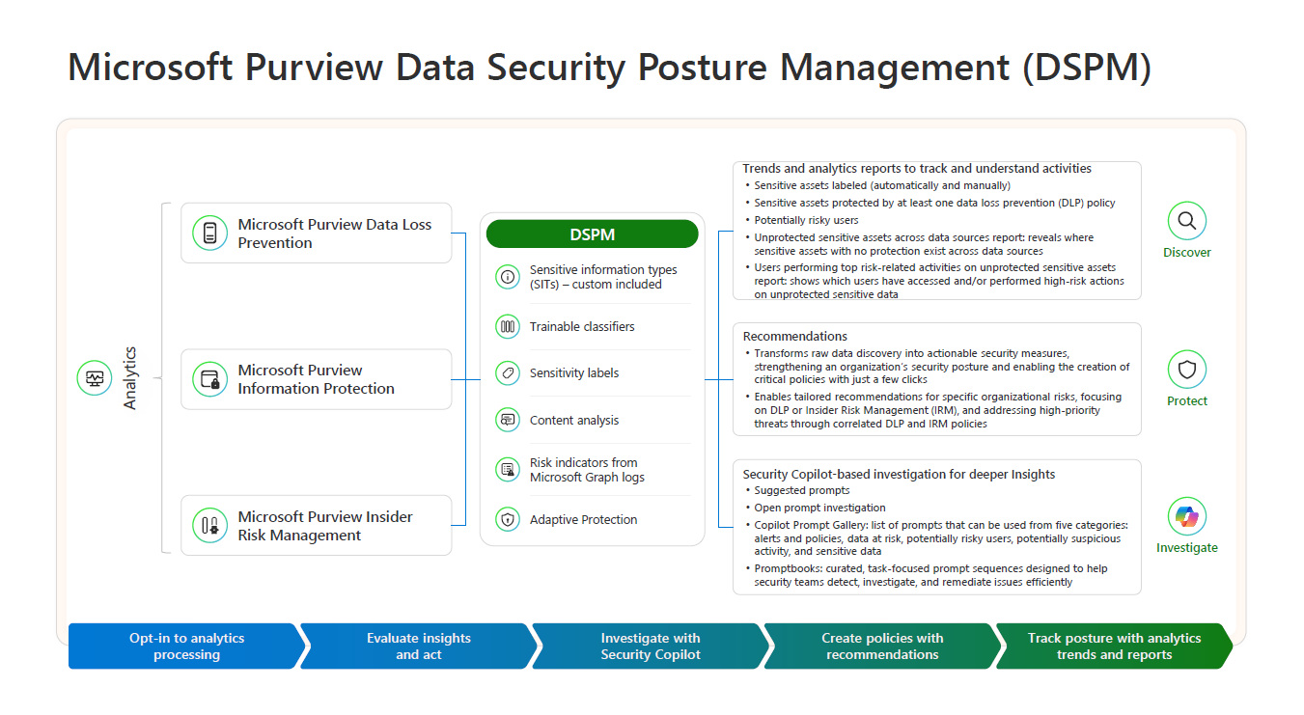
Microsoft Purview
Incumbent-first option for Microsoft data and AI
Strongest when Microsoft 365, Copilot, Entra, endpoints, Fabric, and Purview labels define the control plane.
Validate previews, licensing, regions, prerequisites, partner dependencies, and non-Microsoft coverage.
Visual credit: Microsoft Learn, “Deploy and use Data Security Posture Management” (vendor-authored workflow)
Created with AskAnything · askanything-app.com

Slide 13
Securiti / Veeam
Governance, privacy, AI trust, and resilience
Distinctive hypothesis: one inventory and policy plane across production, secondary data, privacy, governance, AI, and resilience
Principal risk: acquisition integration
Score shipping integration separately from roadmap
Omdia; Veeam acquisition completion
Created with AskAnything · askanything-app.com

Slide 14
Proofpoint DSPM
Human risk, lineage, DLP, and attack paths
Normalyze-derived classification across cloud and on-premises
Strategic case: connect posture with Proofpoint’s human-centric security and DLP
Validate whether identity, policy, incidents, classifiers, telemetry, administration, and licensing are truly unified
Proofpoint product and technical documentation; CSO
Created with AskAnything · askanything-app.com

Slide 15
Conditional specialists
Use when the operating model fits
Palo Alto: Cortex/SOC consolidation
Rubrik: posture plus backup, recovery, and Copilot readiness
Thales: discovery to encryption, tokenization, masking, and keys
Concentric AI: semantic unstructured data and least privilege
IBM Guardium: incumbent and regulated-enterprise RFPs
Approved article; Omdia; CSO; vendor documentation
Created with AskAnything · askanything-app.com

Slide 16
Not default—but credible in context
Installed-base choices
OpenText: reasonable for its installed base; prove integrated cloud usability
Skyhigh: include where SSE/CASB integration is strategic
Tenable: exposure-management operating model
OneTrust: privacy-led program; verify security depth
Native cloud services: baselines and enforcement targets
Approved article; Omdia; CSO; Microsoft Learn
Created with AskAnything · askanything-app.com

Slide 17
Scenario A: Multicloud, cloud-native engineering
Shortlist by operating model
Start: Cyera, Sentra, Wiz
Add BigID for heterogeneity/governance; Palo Alto if Cortex is strategic
Test exact databases, object stores, lakehouses, Kubernetes volumes, serverless, code, vectors, AI, and cross-account identity
Approved article, scenario guidance
Created with AskAnything · askanything-app.com

Slide 18
Scenario B: Microsoft 365, Copilot, file shares, SaaS
Shortlist by operating model
Start: Varonis, Purview, Cyera or BigID
Add Rubrik when resilience and Copilot readiness link
Test groups, external sharing, guests, stale identities, labels, movement, and Copilot reachability
Approved article, scenario guidance
Created with AskAnything · askanything-app.com

Slide 19
Scenario C: Privacy, records, governance, security
Shortlist by operating model
Start: BigID, Securiti/Veeam, Cyera
Add OneTrust if already strategic
Demand one shared inventory across privacy, retention, residency, ownership, exposure, and AI use
Approved article, scenario guidance
Created with AskAnything · askanything-app.com

Slide 20
Scenario D: Regulated data & cryptographic control
Shortlist by operating model
Start: Thales, IBM Guardium, BigID or Cyera
Add incumbent database-activity monitoring
Prove discovery through tokenization, masking, encryption or access change—and verify the application still works
Approved article, scenario guidance
Created with AskAnything · askanything-app.com

Slide 21
Scenario E: Exfiltration, insider risk & DLP
Shortlist by operating model
Start: Varonis, Proofpoint, Cyera
Consider Concentric AI for semantic DLP; Purview for Microsoft endpoints/productivity
Require movement, behavior, content context, enforcement, investigation, and recorded outcome
Approved article, scenario guidance
Created with AskAnything · askanything-app.com

Slide 22
Scenario F: Recovery and cyber resilience first
Shortlist by operating model
Start: Rubrik and Securiti/Veeam
Add Cyera, BigID, or Varonis as independent discovery benchmark
Test live production coverage and effective access; make specialists show protection and recoverability
Approved article, scenario guidance
Created with AskAnything · askanything-app.com

Slide 23
1–2. Estate and corpus
Make coverage measurable
Create a source ledger before inviting vendors
Use lawful synthetic or authorized data
Include exact, near-match, custom, multilingual, tabular, JSON, archive, scan, office, duplicate, transformed, stale, encrypted, mislabeled, and unowned cases
Record ground truth; calculate precision, recall, false positives, false negatives, time, and freshness
Approved article, rigorous proof-of-value method
Created with AskAnything · askanything-app.com

Slide 24
3–4. Access graph and architecture
Explain reachability and scan cost
Test direct/inherited grants, nested groups, conditions, cross-tenant trust, links, guests, services, agents, dormant identities, network exposure, and actual use
Require an explainable identity → entitlement → workload/service → sensitive object path
Verify control-plane/scanner locations, transmitted data, privileges, impact, cadence, failures, and recovery
Approved article, rigorous proof-of-value method
Created with AskAnything · askanything-app.com

Slide 25
5–7. Closure, comparison, operations
Measure durable risk reduction
For ten findings, test exact path, least-disruptive fix, approvals, exceptions, method, rollback, verification, and audit trail
Run blind paired comparisons with the same sources, permissions, time, and criteria
Operate for 30–60 days; introduce change and track latency, drift, reopened issues, analyst time, connector failures, spend, and throttling
Approved article, rigorous proof-of-value method
Created with AskAnything · askanything-app.com

Slide 26
Weighted scorecard
Default weights; adjust by scenario
Coverage
15%
Classification
15%
Access context
12%
Remediation
12%
Architecture / privacy
10%
Risk context
8%
Activity / lineage / DDR
8%
Performance / cost
8%
Integrations
5%
Administration / support
4%
Vendor / roadmap
3%
Approved article, suggested weighted scorecard
Created with AskAnything · askanything-app.com

Slide 27
Pass/fail gates
Apply before weighted scoring
No uncontrolled extraction of prohibited content
No unacceptable production impact
Required residency and regulatory terms
Complete support for the most critical sources
Usable export/API and deletion on termination
No critical remediation without approval, audit, and rollback
Approved article, pass/fail gates
Created with AskAnything · askanything-app.com

Slide 28
Commercial and contracting diligence
Normalize the bids
Cost model
Contract outcomes
Scanned/rescanned data and object counts
Production vs backup copies
Connectors, scanners, regions, tenants
Modules, cloud charges, SIEM ingestion
Services, classifiers, support, managed operations
Named source/service/version matrix
Connector and classification service levels
Processing and subprocessor commitments
Ownership, export, deletion, price protection
Acceptance criteria tied to proof of value
Approved article; CSO pricing discussion
Created with AskAnything · askanything-app.com

Slide 29
Practical red flags
Evidence gaps to challenge
Logo wall without field-level support
Precision without recall
“No data leaves” without a data-flow diagram
“Real time” based on daily scans
Unexplained risk scoring
Ticket-only remediation
Automation without blast-radius analysis and rollback
AI claims without boundaries, evaluation data, and review
Roadmap counted as shipping
Suite discount without specialist benchmark
Compliance reports presented as compliance
No exit path
Approved article, practical red flags
Created with AskAnything · askanything-app.com

Slide 30
What the evidence supports
And what it cannot decide
Supported
Not established
Credible candidates exist
Centers of gravity materially differ
Analyst lists overlap but do not agree
Shortlisting must follow operating model
Best classification recall
Most accurate effective access
Lowest total cost
Fewest irrelevant alerts
Generalized scale or time-to-value
Complete acquisition integration
Reliable AI suggestions
Approved article, evidence limitations
Created with AskAnything · askanything-app.com

Slide 31
Final recommendation
A focused, testable starting point
Invite Cyera, BigID, and either Varonis or Wiz—based on collaboration/permissions versus cloud attack paths
Substitute Sentra for cloud-data-platform focus; add ecosystem specialists only where the operating model demands them
Select the product that accurately finds material sensitive assets, explains reachability, detects meaningful change, and safely closes exposure
Judge results on representative data, acceptable privileges, operational fit, and total cost
Approved article, final recommendation
Created with AskAnything · askanything-app.com

Slide 32
Sources
Full URLs remain in answer.pdf and answer.docx
*CSO*, “DSPM buyer’s guide: Top 10 data security posture management tools,” 27 May 2026 • csoonline.com
Omdia Universe: Data Security Posture Management, 2025 • cpl.thalesgroup.com
Cyera DSPM • cyera.com
BigID DSPM • bigid.com
BigID DSPM + AI-SPM • home.bigid.com
Varonis SSPM/data security • varonis.com
Sentra DSPM glossary • sentra.io
Wiz DSPM • wiz.io
Wiz, “Wiz extends DSPM capabilities to code bases,” 12 March 2024 • wiz.io
Microsoft Learn, “Learn about Data Security Posture Management” • learn.microsoft.com
Microsoft Learn, Data Security Posture agent • learn.microsoft.com
Microsoft Learn, “Deploy and use Data Security Posture Management” • learn.microsoft.com
Veeam acquisition completion • veeam.com
Proofpoint, “Normalyze is now Proofpoint” • proofpoint.com
Proofpoint DSPM buyer guide • proofpoint.com
Proofpoint/Normalyze, data in motion and lineage • proofpoint.com
Palo Alto Networks Prisma Cloud Field Guide • start.paloaltonetworks.com
Rubrik, “What Is DSPM?” • rubrik.com
Rubrik DSPM for Microsoft 365 Copilot • rubrik.com
Rubrik fintech customer story • rubrik.com
Concentric AI • concentric.ai
Explore more questions at Ask Anything
Complete linked source ledger: answer.pdf and answer.docx
Created with AskAnything · askanything-app.com

