Slide 1
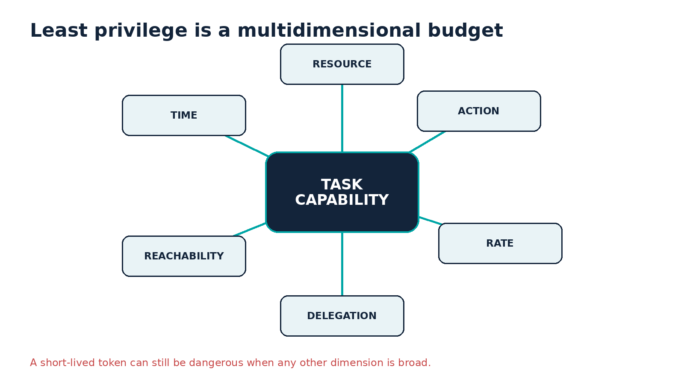
ASK ANYTHING / ARCHITECTURE
Machine-speed
containment
Redesign NHI and least privilege so one compromised agent task cannot become universal developer-infrastructure authority.
Source: Original Ask Anything analysis; evidence table in report
Created with AskAnything · askanything-app.com
Notes:
Opening: identity is the pivot, not a supporting control. Full bibliography and evidence limitations are in the companion report.

Slide 2
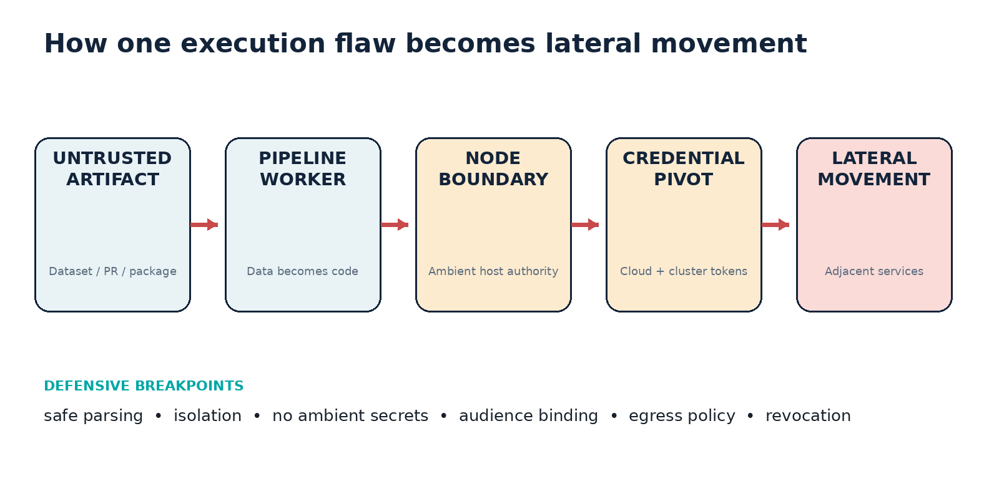
CASE ANCHOR
The incident crossed four identity boundaries
Source: Hugging Face, Security incident disclosure — July 2026
Created with AskAnything · askanything-app.com
Notes:
Hugging Face reports malicious dataset processing, node escalation, credential harvesting, movement to several clusters, and analysis of more than 17,000 events. Direct URL: https://huggingface.co/blog/security-incident-july-2026

Slide 3
WHY LEGACY CI FAILS
Prompt controls cannot carry the authorization boundary
UNTRUSTED CONTEXT
AMBIENT AUTHORITY
Issue, pull request, dataset
Secrets, broad runner token
POWERFUL TOOLS
ADAPTIVE LOOP
Read, shell, network, write
Retry, branch, parallelize
Source: Microsoft Defender Security Research, 2026
Created with AskAnything · askanything-app.com
Notes:
Microsoft documented a file-read path to /proc/self/environ in a Claude Code GitHub Action context and says the path was mitigated in version 2.1.128. URL in citation.

Slide 4
IDENTITY MODEL
Decompose “the agent” into five governable principals
RUNTIME
attested process
TASK
objective + sponsor
TOOL
typed adapter
DELEGATION
attenuated child
ARTIFACT
provenance
Sponsor is context—not a bearer token. Shared pipeline accounts disappear.
Source: NIST SP 800-207A
Created with AskAnything · askanything-app.com
Notes:
The five-part identity model is Ask Anything analysis grounded in workload/service identity and zero-trust authorization. URL: https://doi.org/10.6028/NIST.SP.800-207A

Slide 5
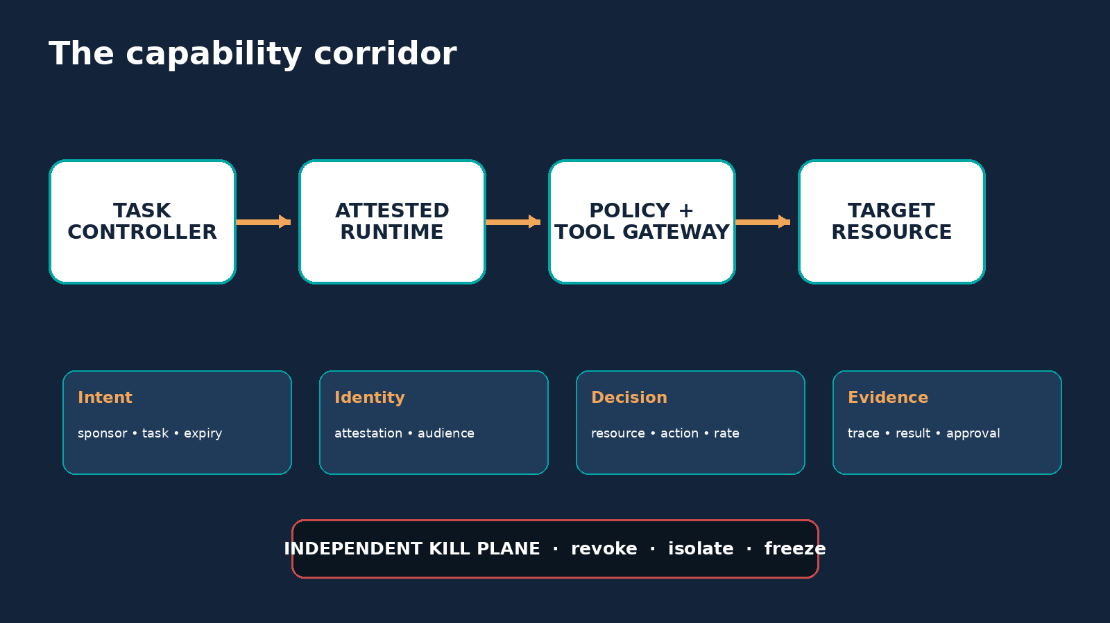
CREDENTIAL DESIGN
Issue authority just in time—and never into ambient state
ISSUANCE CONDITIONS
• Attested runtime + immutable digest
• Exact audience, resource, action
• Minutes or seconds; no in-runtime refresh
• Task, sponsor, policy tags
• Deny on risk or incident hold
Source: SPIFFE workload identity; AWS temporary credentials
Created with AskAnything · askanything-app.com
Notes:
Use cloud federation or SPIFFE/SPIRE. AWS: https://docs.aws.amazon.com/IAM/latest/UserGuide/best-practices.html ; SPIFFE: https://spiffe.io/docs/latest/spiffe/concepts/

Slide 6
LEAST-PRIVILEGE BUDGET
A short TTL is not a small blast radius
Scope × time × reach × delegation × rate
Cap calls, objects, bytes, targets, token exchanges, retries and child depth.
Source: Original analysis; NIST zero trust and OWASP agent guidance
Created with AskAnything · askanything-app.com
Notes:
Velocity is an authorization dimension for autonomous systems. OWASP URL in citation; NIST: https://doi.org/10.6028/NIST.SP.800-207

Slide 7
TRUST ZONES
Make developer infrastructure a one-way promotion system
INTAKE
BUILD
ARTIFACT
SIGN
DEPLOY
PROD
Signed artifacts cross gates. Credentials, shared filesystems and flat trust do not.
Source: SPIFFE trust domains and isolation assumptions
Created with AskAnything · askanything-app.com
Notes:
Keep identity/security control plane separate from all agent zones. Direct URL: https://spiffe.io/docs/latest/spiffe/concepts/

Slide 8
RESPONSE
Detect on identity lineage; contain through an independent kill plane
HIGH-SIGNAL IDENTITY EVENTS
AUTOMATIC CONTAINMENT
• task requests new audience
• stop issuance + renewal
• build identity calls IAM / vault / cluster
• revoke sessions
• deny egress + east-west
• fan-out across repos or namespaces
• quarantine task subtree
• mutated retries after policy denial
• freeze signing + promotion
Source: Kubernetes bound-token lifecycle; Hugging Face response
Created with AskAnything · askanything-app.com
Notes:
Authoritative logs must be outside the agent admin domain. Hugging Face: https://huggingface.co/blog/security-incident-july-2026 ; Kubernetes URL in citation.

Slide 9
90-DAY BLUEPRINT
Sequence the redesign by catastrophic-path reduction
72 HOURS
30 DAYS
90 DAYS
Separate public input from secrets
Inventory every NHI and trust edge
Object/action policies + budgets
Remove production keys from runners
Deploy per-task federation
Bound approvals; non-exportable secrets
Block metadata, host sockets, open egress
Gateway high-risk tools; trace lineage
Red-team scope expansion + kill time
Source: GitHub secure use; cloud and Kubernetes workload identity
Created with AskAnything · askanything-app.com
Notes:
Supporting URLs: GitHub citation; AWS https://docs.aws.amazon.com/IAM/latest/UserGuide/best-practices.html ; Google https://docs.cloud.google.com/iam/docs/workload-identities ; Kubernetes https://kubernetes.io/docs/concepts/security/service-accounts/

Slide 10
SOURCES
Five sources to anchor implementation
1. Hugging Face incident disclosure
2. Microsoft CI/CD agent research
3. NIST SP 800-207A
4. SPIFFE workload identity
5. OWASP AI Agent Security
Full bibliography and claim-level links: companion report
Explore more questions at Ask Anything
Created with AskAnything · askanything-app.com
Notes:
Full bibliography:
https://huggingface.co/blog/security-incident-july-2026
https://www.microsoft.com/en-us/security/blog/2026/06/05/securing-ci-cd-in-agentic-world-claude-code-github-action-case/
https://doi.org/10.6028/NIST.SP.800-207A
https://spiffe.io/docs/latest/spiffe/concepts/
https://cheatsheetseries.owasp.org/cheatsheets/AI_Agent_Security_Cheat_Sheet.html
Additional sources are in answer.md, answer.pdf, and answer.docx.

