Slide 1
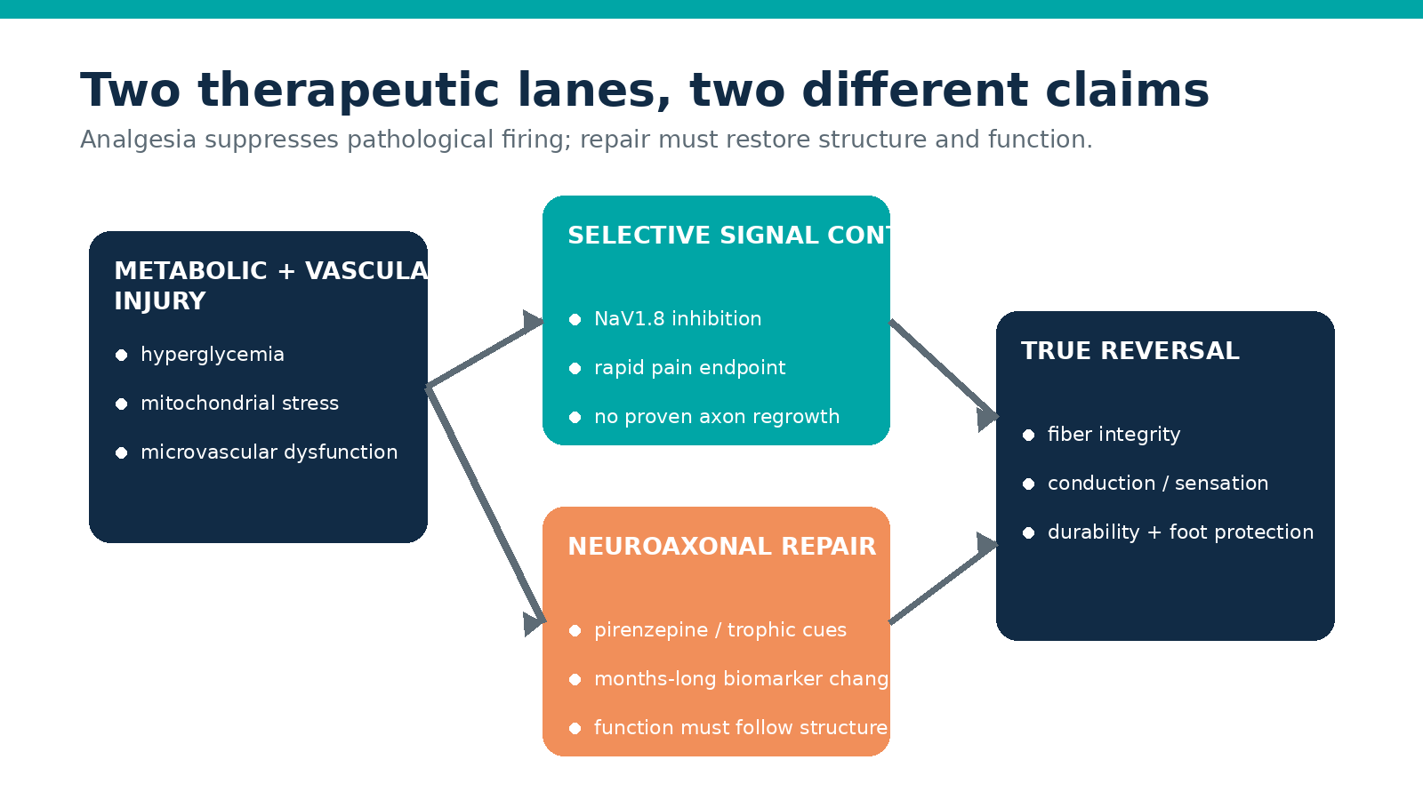
ASK ANYTHING / ADVANCED REVIEW
Rebuilding the
diabetic nerve
Neurovascular repair and selective sodium-channel inhibition
Original illustration: Ask Anything synthesis
Evidence current to 26 July 2026
Created with AskAnything · askanything-app.com
Notes:
Open with the distinction between quieting pathological firing and rebuilding a damaged axon. No treatment has yet shown full reversal.

Slide 2
CLINICAL FRAME
The field is solving two different problems
• NaV1.8 inhibition: rapid analgesia
• Repair: months-long structural recovery
• True reversal needs function + durability
• Pain relief alone can mask sensory loss
Analysis: Ask Anything mechanistic synthesis.
ASK ANYTHING / DPN TRIAL FRONTIERS
2
Created with AskAnything · askanything-app.com
Notes:
Emphasize the endpoint hierarchy. A pain score is not a nerve-regeneration endpoint.

Slide 3
SELECTIVE SIGNAL CONTROL
NaV1.8 is the nearest-term breakthrough
• Peripheral nociceptor target
• Avoids broad sodium-channel blockade
• Non-opioid mechanism
• Does not rebuild lost axons
Damaged nociceptor
Suzetrigine lowers the gain
Analysis: mechanism based on FDA and registered development records.
ASK ANYTHING / DPN TRIAL FRONTIERS
3
Created with AskAnything · askanything-app.com
Notes:
The safety proposition comes from peripheral selectivity, but chronic DPN safety still needs direct evidence.

Slide 4
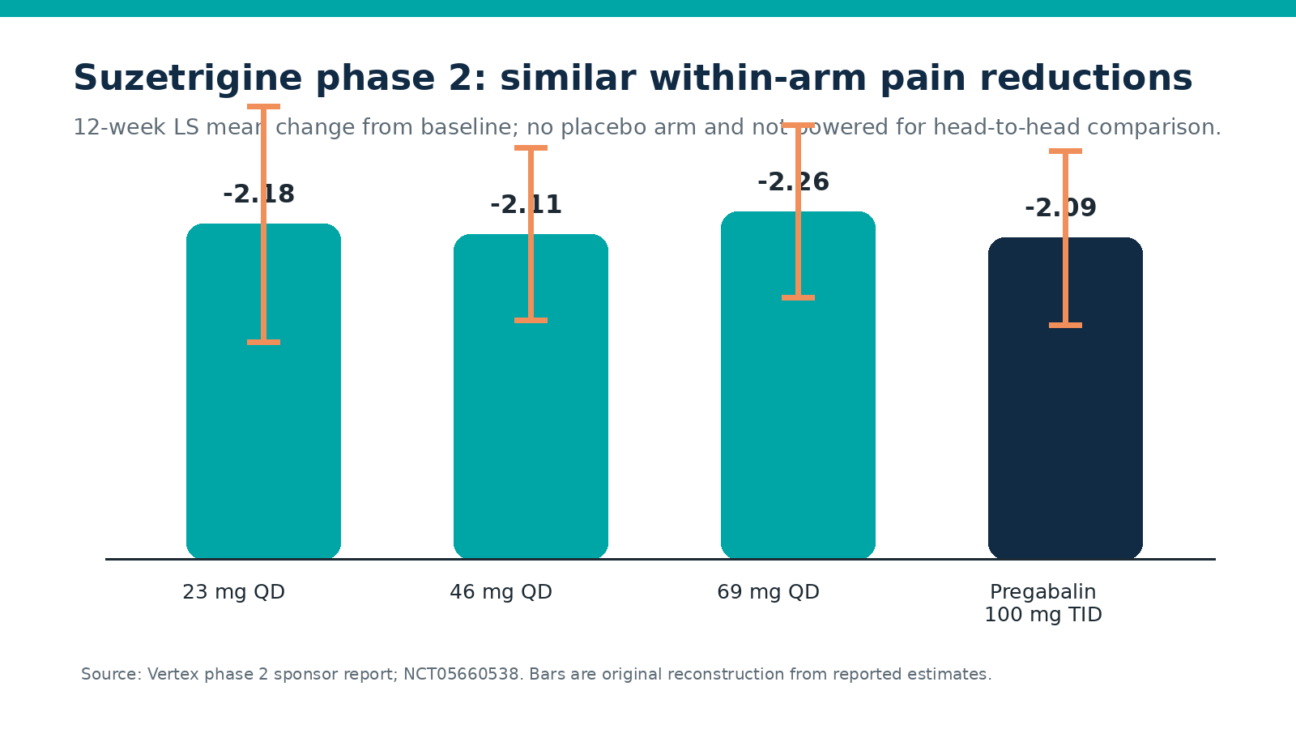
SUZETRIGINE
Phase 2 validates the target—not the treatment effect
N=192 • 12 weeks
All doses: −2.11 to −2.26
Pregabalin: −2.09
No placebo arm
Not powered head-to-head
Source: Vertex phase 2 report; NCT05660538. Original reconstruction.
ASK ANYTHING / DPN TRIAL FRONTIERS
4
Created with AskAnything · askanything-app.com
Notes:
The within-arm p values do not establish superiority to placebo. The overlapping exposures and effects also weaken dose-response inference.

Slide 5
PIVOTAL PROGRAM
Phase 3 is designed to answer the placebo question
Screen
Randomize
Week 12
Extension
→
→
→
painful DPN
objective diagnosis
suzetrigine 70 mg
placebo
pregabalin*
average daily
pain endpoint
long-term safety
455 enrolled
First pivotal study: ~1,100 participants • estimated primary completion May 2027
Sources: NCT06628908; NCT07231419; NCT06696443. *Pregabalin in first study.
ASK ANYTHING / DPN TRIAL FRONTIERS
5
Created with AskAnything · askanything-app.com
Notes:
Describe the primary placebo comparison and the key secondary non-inferiority benchmark against pregabalin.

Slide 6
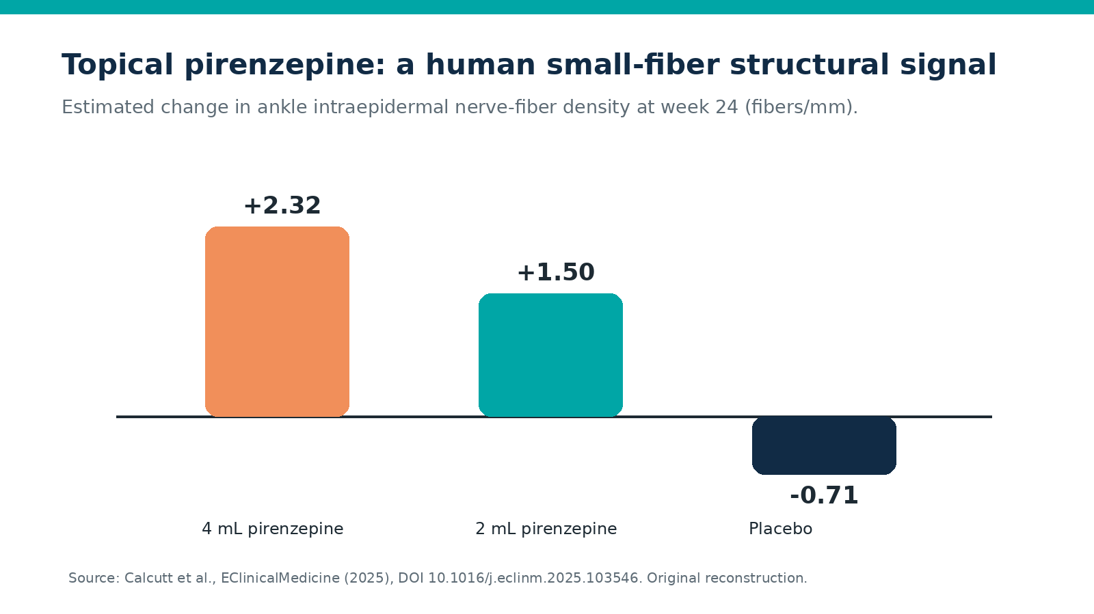
SMALL-FIBER REGENERATION
Pirenzepine offers the clearest recent repair signal
N=58 • 24 weeks
IENFD increased at both doses
Safety-led phase 2a
Function and durability remain unproven
Source: Calcutt et al., EClinicalMedicine 2025; NCT04005287. Original reconstruction.
ASK ANYTHING / DPN TRIAL FRONTIERS
6
Created with AskAnything · askanything-app.com
Notes:
This is a structural biomarker signal. Avoid saying it proves restored sensation or reduced ulcers.

Slide 7
NEUROVASCULAR REPAIR
VM202 shows why plausibility is not proof
HGF plasmid in calf muscle
Mechanism ≠ outcome
• Angiogenic + neurotrophic rationale
• Phase 3: 500 participants
• Primary and other efficacy endpoints negative
• Subgroup signals remain exploratory
Require nerve target engagement,
objective neural rescue,
and a positive prespecified endpoint.
Source: Kessler et al., Clin Transl Sci 2021; NCT02427464.
ASK ANYTHING / DPN TRIAL FRONTIERS
7
Created with AskAnything · askanything-app.com
Notes:
The randomized null result carries more weight than post hoc subgroup observations.

Slide 8
DEVELOPMENT BLUEPRINT
A reversal trial needs concordant evidence
STRUCTURE
FUNCTION
CLINICAL
DURABILITY
IENFD or corneal
nerve-fiber length
conduction, sensory
thresholds, gait
quality of life,
falls, foot protection
benefit after
treatment withdrawal
Repair claim only if the domains move together and safety remains compatible with chronic use.
Analysis: Ask Anything proposed evidentiary framework.
ASK ANYTHING / DPN TRIAL FRONTIERS
8
Created with AskAnything · askanything-app.com
Notes:
A hierarchical endpoint limits false-positive claims and forces structural findings to connect to meaningful function.

Slide 9
PRACTICE AND TRIAL IMPLICATIONS
Match the mechanism to the phenotype
Painful + hyperexcitable
preserved fibers
NaV1.8 inhibition
rapid symptom control
Early–moderate axon loss
repair reserve present
Topical/local repair
structure + function
Advanced insensate DPN
severe axon depletion
prevention + protection
longer horizon
Do not use acute-pain approval as evidence for chronic DPN treatment.
Analysis: phenotype-led synthesis of available trial evidence.
ASK ANYTHING / DPN TRIAL FRONTIERS
9
Created with AskAnything · askanything-app.com
Notes:
For current practice, no candidate should be presented as approved DPN reversal therapy.

Slide 10
SOURCES
Five records anchor the decision
1 Vertex. Suzetrigine phase 2 DPN results (2023); NCT05660538.
2 ClinicalTrials.gov. Suzetrigine pivotal study NCT06628908.
3 Calcutt et al. EClinicalMedicine 2025; DOI 10.1016/j.eclinm.2025.103546.
4 Kessler et al. Clin Transl Sci 2021; DOI 10.1111/cts.12977.
5 FDA. Journavx prescribing information, revised 2026.
Full bibliography and direct links: companion report.
Explore more questions at Ask Anything
ASK ANYTHING / DPN TRIAL FRONTIERS
10
Created with AskAnything · askanything-app.com
Notes:
Full bibliography: see answer.md / answer.pdf. URLs: https://clinicaltrials.gov/study/NCT05660538 ; https://clinicaltrials.gov/study/NCT06628908 ; https://doi.org/10.1016/j.eclinm.2025.103546 ; https://doi.org/10.1111/cts.12977 ; https://www.accessdata.fda.gov/drugsatfda_docs/label/2026/219209s009lbl.pdf

