Slide 1
EMPLOYEE TRAINING PROGRAM + HANDBOOK
Phishing Resistance
in 2026
STOP
THINK
Stop. Think. Verify. Report.
VERIFY
60–75 minute core session • role modules • continuous reinforcement
REPORT
Security Awareness / Information Security
Version 1.0 • July 2026
Created with AskAnything · askanything-app.com

Slide 2
EXECUTIVE BRIEF
Why this program exists
• Phishing is now email, text, QR, chat, voice, video—and compromised real accounts.
• Appearance is weak evidence: sender name, grammar, voice, face, padlock, and thread history can mislead.
• The durable signal is an unexpected request plus a consequential action.
• Training must connect people to verification, reporting, containment, and technical controls.
These data sets use different methods and should not be added together.
02
Created with AskAnything · askanything-app.com

Slide 3
LANDSCAPE
What the evidence says
• FBI IC3: 191,561 phishing/spoofing complaints in 2025.
• FBI IC3: 24,768 BEC complaints and $3.047B in reported BEC losses.
• APWG: 971,181 reported phishing attacks in Q1 2026, up 13.8% from Q4 2025.
• Verizon: mobile-centered interactive social engineering had a 40% higher success rate than traditional email phishing in its data.
• Counts are reported complaints or telemetry—not a census of all victimization.
03
Created with AskAnything · askanything-app.com

Slide 4
CORE BEHAVIOR
One response pattern
STOP
THINK
VERIFY
REPORT
before a sensitive or irreversible action
›
about the request—not its polish
›
through a channel you choose
›
immediately, including uncertainty
Fast reporting protects everyone—even after a click.
04
Created with AskAnything · askanything-app.com

Slide 5
THREAT MODEL
A trust-boundary model
• Signing in, approving MFA, scanning a QR code, or opening an attachment.
• Installing support or remote-access software.
• Sharing sensitive records, source code, API keys, or recovery codes.
• Changing bank or payroll details; buying gift cards; moving money.
• Moving a conversation to a personal or external channel—or simply replying.
Ask: what action does this contact want me to take?
05
Created with AskAnything · askanything-app.com

Slide 6
THREAT MODEL
What attackers can convincingly fake
• Names, photos, logos, signatures, branded pages, caller ID, and SMS labels.
• Polished writing, familiar voices, synthetic video, and personal context.
• Lookalike domains, QR codes, cloud services, forms, redirects, and external guests.
• Real supplier, customer, colleague, or executive accounts after compromise.
• A real event’s emotional context: merger, tax season, travel, outage, or urgent deal.
06
Created with AskAnything · askanything-app.com

Slide 7
CONTROL PRINCIPLE
What process makes harder
• A directory callback or a preexisting supplier contact.
• Second-person review for payment changes.
• A rule that no executive can waive verification.
• FIDO/WebAuthn, least privilege, transaction limits, and risk alerts.
• Fast reporting linked to a rehearsed response team.
Verification is a process—not a feeling.
07
Created with AskAnything · askanything-app.com

Slide 8
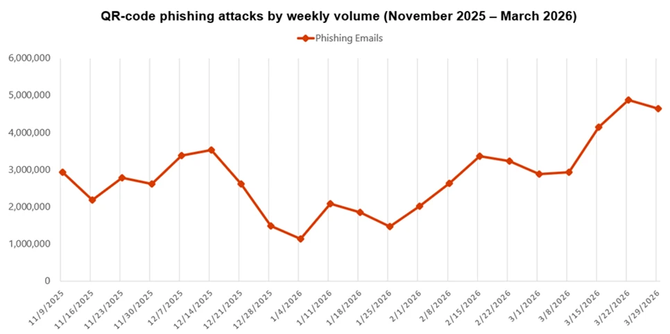
EVIDENCE
QR phishing accelerated in Q1 2026
Microsoft detections: weekly QR-code phishing volume, Nov 2025–Mar 2026
Credit: Microsoft Threat Intelligence & Defender Security Research Team, Fig. 3
08
Created with AskAnything · askanything-app.com

Slide 9
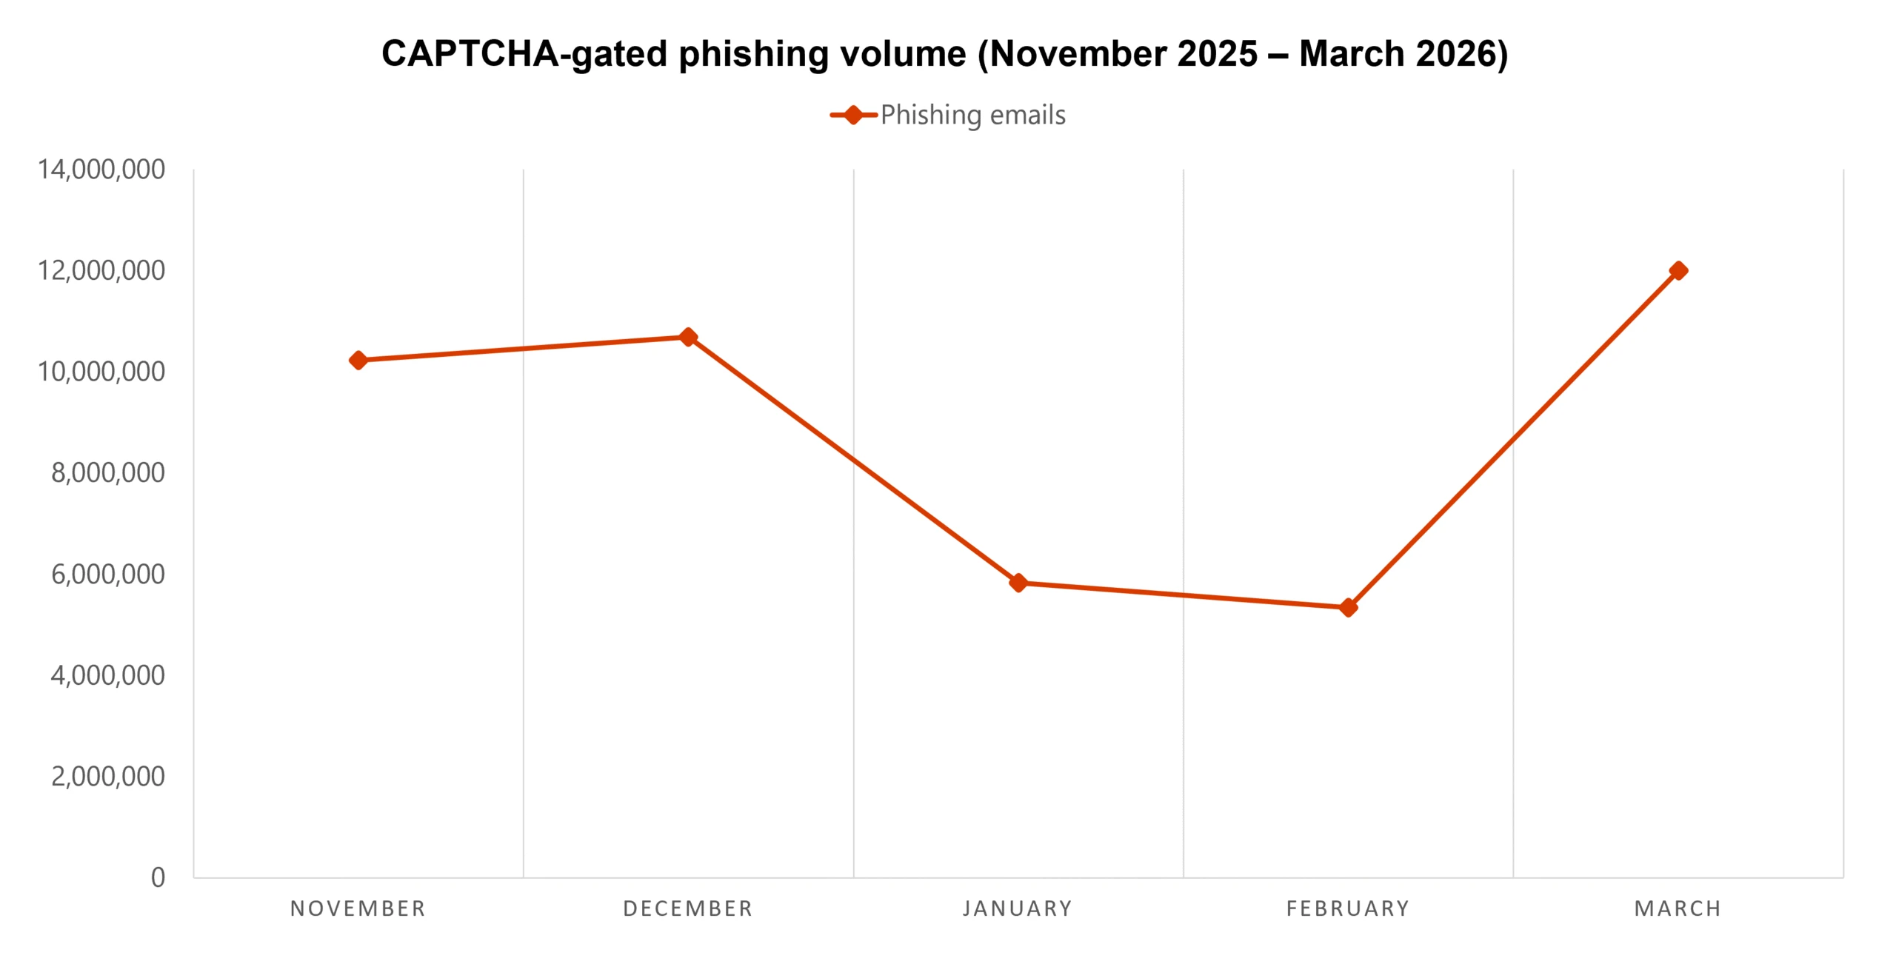
EVIDENCE
CAPTCHA gates add friction—and false legitimacy
Microsoft detections: CAPTCHA-gated phishing volume, Nov 2025–Mar 2026
Credit: Microsoft Threat Intelligence & Defender Security Research Team, Fig. 4
09
Created with AskAnything · askanything-app.com

Slide 10
2026 ATTACK LANDSCAPE
Six channels, one safe decision
• AI-written messages: writing quality is not authentication.
• Voice/video: call back through a trusted directory.
• QR: navigate through the known app or portal.
• MFA: deny unexpected prompts and report immediately.
• Chat/SMS: treat conversation as a message, not proof.
• BEC: verify the business process; the payload may be your authorized action.
10
Created with AskAnything · askanything-app.com

Slide 11
IDENTITY
MFA fatigue and token theft
• Approve only when you initiated the sign-in, at that moment, on the expected service and device.
• Unexpected prompt? Deny or report fraud; never share a code, number match, password, or recovery code.
• Adversary-in-the-middle pages can proxy sign-in and steal session tokens.
• FIDO/WebAuthn is the widely available phishing-resistant approach; number matching is an interim measure.
• If you approved: report now. Do not wait.
11
Created with AskAnything · askanything-app.com

Slide 12
BEC
Business email compromise is process fraud
• It may have no malicious link or attachment.
• Gift cards, wire transfers, payroll diversion, invoices, and confidential legal requests are common pathways.
• A real invoice in a real thread can still carry changed payment details.
• Confidentiality never cancels verification or dual authorization.
• The employee’s authorized action can be the payload.
12
Created with AskAnything · askanything-app.com

Slide 13
MESSAGE INSPECTION
Inspect the sender—but know the limit
• Display name: easy to spoof.
• From address: compare the entire address and expected domain.
• Reply-To: check whether replies are diverted.
• SPF/DKIM/DMARC: useful technical evidence, not proof of benign intent.
• A perfect match can still be a compromised account.
13
Created with AskAnything · askanything-app.com

Slide 14
MESSAGE INSPECTION
Read domains from right to left
• login.northwind.example → the fictional base is northwind.example.
• northwind.example.secure-review.invalid → controlling domain is secure-review.invalid.
• northwínd.example → a lookalike character is not the expected spelling.
• northwind-payments.example ≠ northwind.example.
• Use a bookmark, known portal, or independent directory path.
14
Created with AskAnything · askanything-app.com

Slide 15
MESSAGE INSPECTION
Inspect links without opening
• Hover on desktop; preview cautiously on touch devices.
• Read the destination, not the linked words.
• HTTPS protects transport; it does not certify the site’s owner or intent.
• Do not use a public link expander for sensitive company URLs.
• When uncertain: do not interact—report.
15
Created with AskAnything · askanything-app.com

Slide 16
SCENARIO WALKTHROUGH
Flawless benefits email
THE REQUEST
WHAT TO NOTICE
A polished benefits notice asks you to sign in through a linked page before a deadline.
• Good grammar and branding are not authentication.
• Deadline pressure plus sign-in crosses a trust boundary.
• The visible link text may not be the destination.
SAFE ACTION
Open the known benefits portal independently; report the message.
16
Created with AskAnything · askanything-app.com

Slide 17
SCENARIO WALKTHROUGH
Compromised supplier, real invoice thread
THE REQUEST
WHAT TO NOTICE
A familiar supplier account replies in a real thread and supplies new bank details.
• Conversation history can be genuine.
• A correct invoice does not validate changed bank details.
• Emailing back stays inside the possibly compromised channel.
SAFE ACTION
Call the preexisting vendor-master contact; require second review.
17
Created with AskAnything · askanything-app.com

Slide 18
SCENARIO WALKTHROUGH
CEO gift cards by text
THE REQUEST
WHAT TO NOTICE
“I’m in a meeting. Keep this confidential. Buy cards now and send the codes.”
• Authority, secrecy, and urgency are the mechanism.
• Small initial amounts may escalate.
• Codes are equivalent to sending value.
SAFE ACTION
Follow the purchasing workflow and verify through a known number.
18
Created with AskAnything · askanything-app.com

Slide 19
SCENARIO WALKTHROUGH
Teams ‘IT support’
THE REQUEST
WHAT TO NOTICE
An unsolicited external contact offers urgent support and asks for a device code or screen control.
• Chat identity is not proof.
• Real platform functions can support social engineering.
• Device codes and remote control cross identity and device boundaries.
SAFE ACTION
End contact; use the company help portal or directory.
19
Created with AskAnything · askanything-app.com

Slide 20
SCENARIO WALKTHROUGH
QR-code document
THE REQUEST
WHAT TO NOTICE
A PDF asks you to scan a QR code to view a document, reset MFA, or fix an account.
• A QR code is an obscured link.
• The phone may have fewer enterprise protections.
• A PDF attachment does not make the destination internal.
SAFE ACTION
Use the known application or company portal instead.
20
Created with AskAnything · askanything-app.com

Slide 21
SCENARIO WALKTHROUGH
MFA fatigue plus voice call
THE REQUEST
WHAT TO NOTICE
Repeated prompts arrive; a caller claiming to be support asks you to approve one.
• The password may already be compromised.
• The call and prompts reinforce the same manipulation.
• IT should never need your password or one-time code.
SAFE ACTION
Deny, stop the call, and report immediately—including any approval.
21
Created with AskAnything · askanything-app.com

Slide 22
SCENARIO WALKTHROUGH
Payroll diversion
THE REQUEST
WHAT TO NOTICE
A message from an employee—or personal address—asks payroll to change direct deposit.
• A manager’s emailed approval is not identity proof.
• Bank changes are high-risk identity events.
• The contact path supplied in the request is not independent.
SAFE ACTION
Use the authenticated HR system and a previously registered channel.
22
Created with AskAnything · askanything-app.com

Slide 23
RESPONSE PATTERN
STOP: create decision space
• Pause before opening, signing in, approving, installing, disclosing, or paying.
• Do not let urgency, secrecy, authority, fear, scarcity, or helpfulness choose for you.
• A short pause is a control—not a failure of service.
You are not expected to be a forensic analyst.
23
Created with AskAnything · askanything-app.com

Slide 24
RESPONSE PATTERN
THINK: interrogate the request
• Did I expect this contact and this action?
• What trust boundary would I cross?
• Is the request trying to move me to a different channel?
• Would policy normally require another person, an authenticated system, or a known workflow?
• Could the real account or thread be compromised?
24
Created with AskAnything · askanything-app.com

Slide 25
RESPONSE PATTERN
VERIFY: choose the channel
• Retrieve the number or application independently.
• Call the directory number or preexisting vendor contact.
• Use the authenticated HR, finance, benefits, or help-desk system.
• Require dual control for financial or sensitive changes.
• Never accept ‘the executive says policy does not apply.’
25
Created with AskAnything · askanything-app.com

Slide 26
RESPONSE PATTERN
REPORT: fast, factual, no blame
• Use the one-click report control or documented security channel.
• Report uncertainty, false alarms, and mistakes.
• State what happened: clicked, entered credentials, approved MFA, installed software, disclosed data, or sent money.
• Do not delete evidence or spend time investigating on your own.
• Managers thank the reporter and escalate—without interrogation or blame.
26
Created with AskAnything · askanything-app.com

Slide 27
CONTAINMENT
The first minutes after a bad click
• Clicked only: close the page; report; follow security guidance.
• Entered password: report; change it from a clean path; let responders revoke sessions.
• Approved MFA / supplied code / registered key: report immediately and say exactly what happened.
• Ran software: disconnect as instructed; do not power off unless told.
• Sent data or money: report to security and the business response path at once.
Fast reporting can preserve options—even after money is sent.
27
Created with AskAnything · askanything-app.com

Slide 28
ROLE-BASED CONTROLS
Role modules: enhanced procedures
• Finance/AP: vendor-master callbacks, dual review, holds, alerts, recovery drills.
• Payroll/HR: authenticated changes, identity proofing, registered-channel notice.
• Executives/EAs: publicly endorse verification; never request policy bypass.
• IT/help desk: strong reset proofing; no credential or MFA-code collection.
• Developers/admins: protect tokens, secrets, cloud consent, and privileged sessions.
28
Created with AskAnything · askanything-app.com

Slide 29
DELIVERY PLAN
Deliver the core in 60–75 minutes
• Opening and trust-boundary model.
• Current channels and evidence.
• Sender, domain, link, and context inspection.
• Scenario practice using Stop–Think–Verify–Report.
• No-blame reporting and first-minute response.
• Knowledge check and local reporting demonstration.
29
Created with AskAnything · askanything-app.com

Slide 30
CONTINUOUS PROGRAM
Beyond the annual course
• Short, repeated, role-relevant learning and simulations.
• A visible reporting path with useful feedback.
• Process drills for payments, payroll, help desk, and incident response.
• Vary channel, context, and difficulty—without humiliation.
• Use simulations to rehearse and measure systems, not to punish individuals.
30
Created with AskAnything · askanything-app.com

Slide 31
EVIDENCE LIMITS
What training evidence does—and does not—support
• A 2025 randomized field experiment found no relationship between annual-training recency and simulation failure.
• Embedded training reduced failure by about two percentage points on average.
• Many training-page visits were brief; formal completion was below 24%.
• NIST warns click rate is confounded by lure difficulty and work context.
• Training is one layer; it is not a firewall.
31
Created with AskAnything · askanything-app.com

Slide 32
DEFENSE IN DEPTH
Technical and process safety net
• Identity: FIDO/WebAuthn, conditional access, session revocation, enrollment alerts.
• Email/domains: authentication, filtering, external labels, lookalike monitoring.
• Collaboration/mobile: restrict external contact, govern apps, detect risky behavior.
• Endpoints: managed browsers, application control, EDR, least privilege.
• Finance/data: dual authorization, transaction limits, change alerts, data controls.
• Response: one-click reporting, telemetry, playbooks, legal/comms and fund recovery.
32
Created with AskAnything · askanything-app.com

Slide 33
MEASUREMENT
Measure outcomes—not theater
• Report rate and time to report.
• Time to triage, contain, revoke sessions, and contact financial partners.
• Verification adherence for payment, payroll, reset, and sensitive-data workflows.
• Repeat patterns by role and scenario difficulty—not a public individual score.
• Control adoption: phishing-resistant MFA, dual control, external-chat policy, rehearsed response.
33
Created with AskAnything · askanything-app.com

Slide 34
ROADMAP
A twelve-month implementation arc
• Months 1–3: policy, reporting path, baseline controls, manager scripts.
• Months 4–6: core delivery, role modules, scenario practice, initial metrics.
• Months 7–9: varied simulations, process drills, control gaps, feedback loops.
• Months 10–12: evaluate trends with difficulty/context, refresh content, rehearse recovery.
• Govern with security, HR, legal, finance, IT, privacy, and employee representation as appropriate.
34
Created with AskAnything · askanything-app.com

Slide 35
TAKEAWAY
Employee quick reference
• STOP before links, logins, approvals, installs, disclosures, or payments.
• THINK: unexpected request + consequential action = verify.
• VERIFY using a channel or workflow you retrieve independently.
• REPORT immediately—even if unsure, even after a mistake.
• After action: say exactly what happened so responders can move quickly.
Stop. Think. Verify. Report.
35
Created with AskAnything · askanything-app.com

Slide 36
REFERENCES
Source ledger • threat landscape
• FBI IC3, 2025 Annual Report.
• APWG, Phishing Activity Trends Report, Q1 2026.
• Verizon, 2026 Data Breach Investigations Report.
• Microsoft Threat Intelligence, Email threat landscape Q1 2026.
• Microsoft Incident Response, Teams support-call compromise.
• Microsoft Threat Intelligence, Teams abuse and AiTM token compromise.
• FTC, QR-code scam guidance; FBI/IC3 voice-imitation PSA.
36
Created with AskAnything · askanything-app.com

Slide 37
FULL LEDGER
Sources
• CISA: More than a Password; phishing-resistant MFA fact sheet.
• Ho et al., IEEE S&P 2025: Understanding the Efficacy of Phishing Training in Practice.
• Gordon et al., JAMIA 2019: mandatory phishing training evaluation.
• NIST Phish Scale research and Technical Note 2276.
• Greene et al. 2018; Siadati et al. 2017; Chen et al., SOUPS 2024.
• NIST SP 800-50 Rev. 1, 2024.
• Full linked source ledger and reusable-asset credits: answer.docx / answer.pdf.
CISA
IEEE S&P
JAMIA
NIST Phish Scale
NIST Context
NIST SP 800-50
Explore more questions at Ask Anything
37
Created with AskAnything · askanything-app.com

