Slide 1
TECHNICAL MARKET MAP • 28 JULY 2026
Enterprise AI-agent security
beyond agent DLP
The buying question is not one detector. It is whether every authority-bearing dataflow is governed end to end.
Security architecture • IAM • Data security • AI platform teams
Created with AskAnything · askanything-app.com

Slide 2
THREAT MODEL
The problem is an authority-bearing dataflow
Untrusted content → model context → plan → credential → tool call → system → side effect
• The attacker needs both a source of untrusted instructions and a sink the agent can reach.
• Prompt injection remains an open problem; model alignment is not authorization.
• Benchmarks show non-zero attack success, but they do not estimate enterprise breach frequency.
Created with AskAnything · askanything-app.com

Slide 3
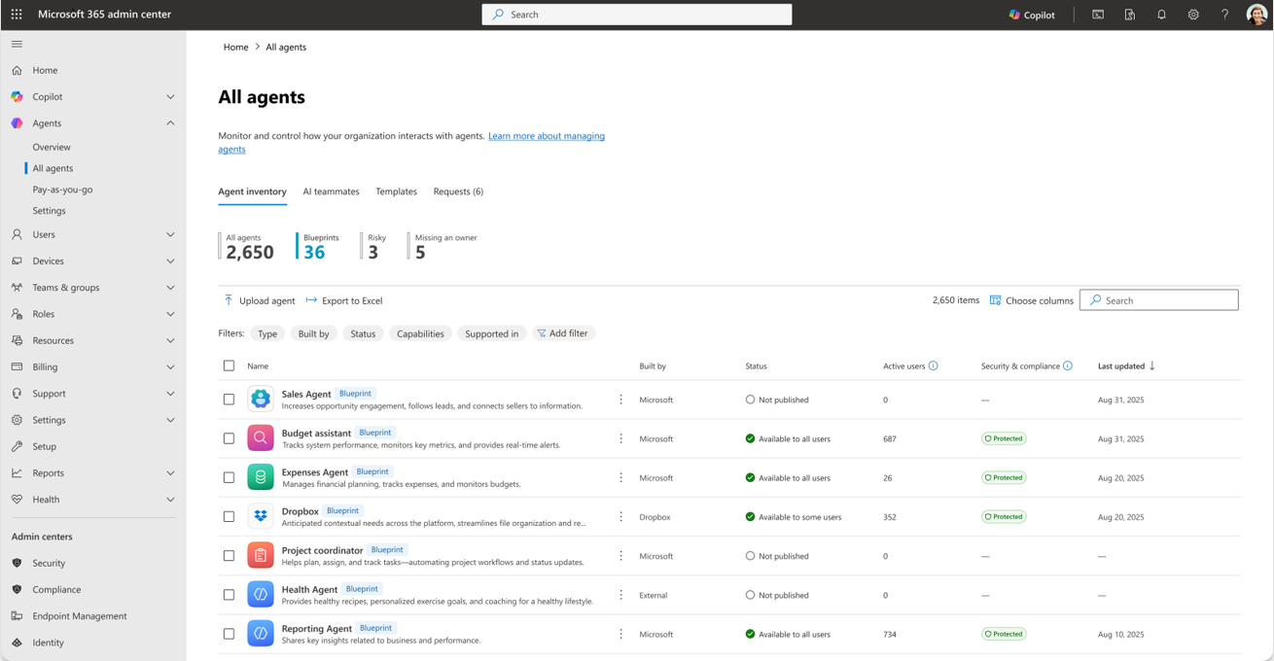
CONTROL PLANE
Microsoft: one governance plane for a Microsoft-first estate
• Registry ties agents to owners, identities and permissions.
• Best fit where Entra, Purview, Defender and Intune already carry context.
• Verify exact third-party, local-runtime and OS coverage; some runtime controls remain preview.
Source: Microsoft Learn — “Secure AI agents at scale using Microsoft Agent 365”
Created with AskAnything · askanything-app.com

Slide 4
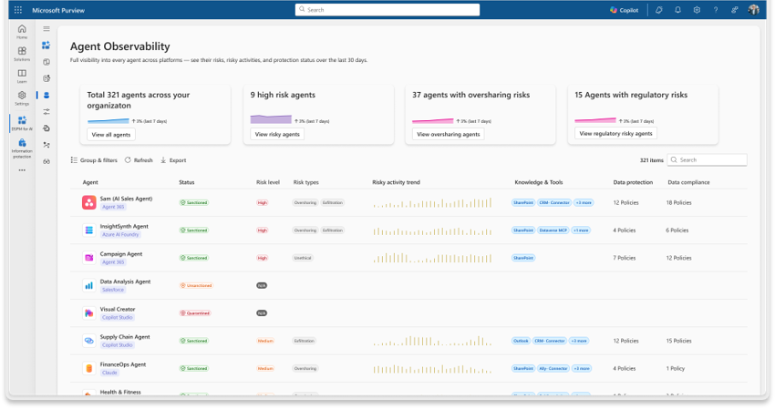
MICROSOFT PURVIEW
Data controls matter before and after retrieval
• Sensitivity labels, DLP, audit and investigation can follow supported content into agent interactions.
• A registry entry does not prove every tool call can be blocked.
• The proof of concept must exercise the real runtime, connector and permission mode.
Source: Microsoft Learn — “Secure AI agents at scale using Microsoft Agent 365”
Created with AskAnything · askanything-app.com

Slide 5
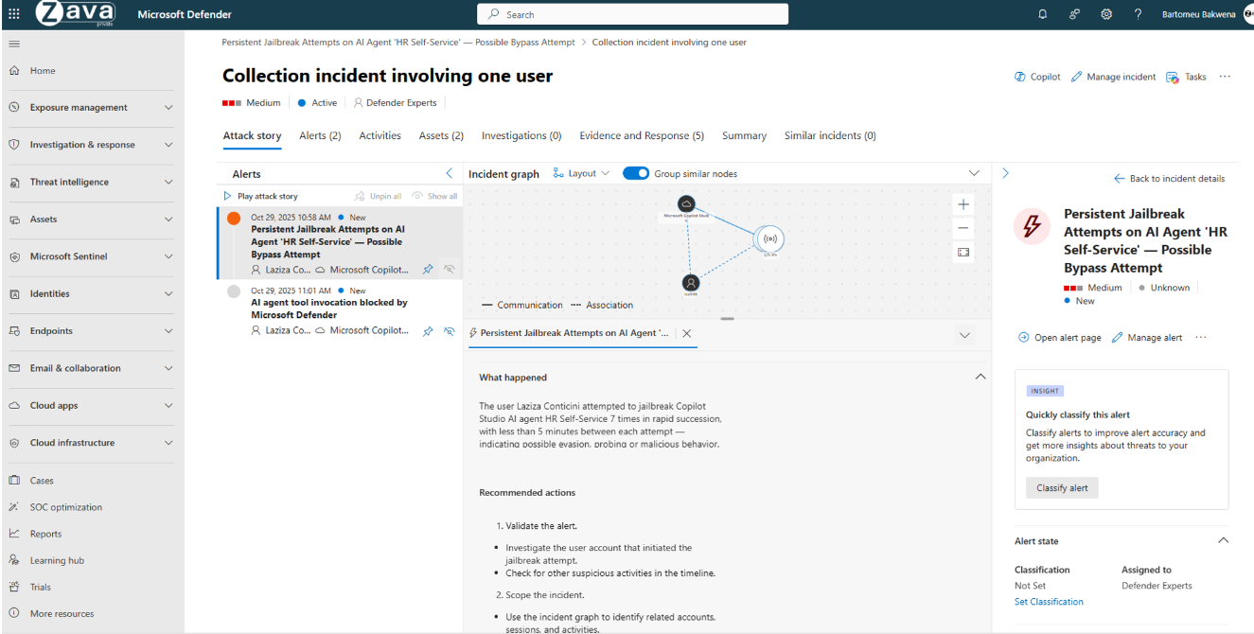
MICROSOFT DEFENDER
Investigation must connect agent activity to response
• Posture and runtime telemetry should produce a replayable evidence chain.
• For supported local agents, documented controls inspect tool responses and can block injection-triggered actions.
• Containment must revoke credentials as well as stop the process.
Source: Microsoft Learn — “Secure AI agents at scale using Microsoft Agent 365”
Created with AskAnything · askanything-app.com

Slide 6
EVALUATION MAP
The market separates by enforcement point
Suite / identity
SSE / traffic
Agent posture
Microsoft Agent 365
Cisco AI Defense + Astrix
Netskope One AI Security
Zscaler AI Guard
Zenity
Noma Security
Runtime guardrails
Data-centric
Benchmark
Check Point AI Security
HiddenLayer
Thales AI Security Fabric
Securiti
Palo Alto Prisma AIRS
No responsible universal ranking: fit depends on estate, routing, identity, data and runtime reach.
Created with AskAnything · askanything-app.com

Slide 7
REFERENCE ARCHITECTURE
Six independent gates prevent ambient authority
1 Inventory & provenance
2 Separate identity
3 Data minimization
4 Instruction / data separation
5 Deterministic action policy
6 Egress, audit & response
Created with AskAnything · askanything-app.com

Slide 8
PROOF OF CONCEPT
Test representative agents—not a toy chatbot
• Read-heavy knowledge agent: enterprise documents, CRM and web retrieval.
• Write-capable operations agent: messaging, ticketing, source control, cloud APIs or database.
• Segregated tenant with synthetic, realistically classified data.
• Independent ground truth from identity, SaaS, API, endpoint, MCP, database, network and orchestrator logs.
• Measure attack success and benign completion.
• Track false positives / negatives and p50 / p95 / p99 latency.
• Measure cost, discovery lag, time to explain and time to revoke.
• Report by language, modality, framework, transport and data class.
Created with AskAnything · askanything-app.com

Slide 9
BAKE-OFF
Required tests expose reach and failure modes
01 Discovery
02 Direct & indirect injection
03 Cross-system exfiltration
04 Authorization
05 Tool misuse
06 Credential abuse
07 Destructive action
08 Availability
09 Privacy
10 Detection operations
Pass conditions must include deterministic denial, traceability, containment and benign usability.
Created with AskAnything · askanything-app.com

Slide 10
DILIGENCE QUESTIONS
Eliminate weak products quickly
• Can it enforce tool calls and tool responses—not only prompts and final output?
• Does it see local and remote MCP, GUI automation, async jobs and service-to-service calls?
• Can one policy combine initiating human, agent identity, scope, data label, resource and destination?
• What is GA, preview, beta, partner-provided or roadmap?
• What happens on timeout, quota exhaustion or regional failure?
• Can investigators reconstruct which untrusted item influenced which call and records?
Created with AskAnything · askanything-app.com

Slide 11
CONCLUSION
Buying decision: prove narrow authority and revocable evidence
Which combination can prove that every agent has a known owner and narrow identity, sees only task-required data, cannot turn untrusted content into unauthorized authority, and leaves a complete, revocable audit trail?
• Start from the estate: Microsoft, Cisco, Netskope, Zscaler, heterogeneous builders, custom agents, or regulated data.
• Layer traffic inspection, posture, identity, source-level data policy and runtime semantics where each has a defined failure mode.
• Demand written coverage and customer-run adversarial testing for the exact production path.
Created with AskAnything · askanything-app.com

Slide 12
EVIDENCE LEDGER
Sources
Independent / taxonomy
NIST AI 100-2e2025 • OWASP Agentic Top 10 2026
WASP (arXiv:2504.18575) • Alizadeh et al. (arXiv:2506.01055)
OpenAI prompt-injection research • Anthropic Agentic Misalignment
Product documentation
Microsoft Learn: Agent 365 overview, architecture, runtime, licensing
Cisco AI Defense data sheet / DevNet • Cisco–Astrix announcement
Netskope AI Security / Guardrails • Zscaler AI Guard
Zenity • Noma • Astrix
Product documentation, continued
Check Point AI Security (Lakera): API, Guard, defenses
HiddenLayer runtime • Thales AI Security Fabric • Securiti
Palo Alto Prisma AIRS overview and low/no-code agent security
Full linked source ledger and direct URLs:
See answer.pdf and answer.docx
Documentary visual credit
Microsoft Learn, “Secure AI agents at scale using Microsoft Agent 365”
Vendor documentation supports feature descriptions; it does not independently prove efficacy.
Explore more questions at Ask Anything
Created with AskAnything · askanything-app.com

