Slide 1
One request. Five policy lenses.
A unified enterprise video curriculum
Teach Rule-BAC, RBAC, ABAC, MAC, and DAC as simultaneous constraints—not competing products.
Recommended product: 75–90 minute branching-video core + role practice + scored capstone simulation.
Success means the right outcome and the right rationale. A lucky “deny” is not evidence of comprehension.
Northstar Group • evidence-led access-control curriculum
1
Created with AskAnything · askanything-app.com

Slide 2
The common decision object
A stable notation prevents authentication/authorization confusion
SUBJECT → ACTION → OBJECT / RESOURCE → ENVIRONMENT → ENTERPRISE POLICIES
Authentication asks: “Who are you?”
Authorization asks: “May this subject perform this action on this resource now?”
Every scenario reuses the same request notation and evidence trail.
Northstar Group • evidence-led access-control curriculum
2
Created with AskAnything · askanything-app.com

Slide 3
Five lenses—different authority, overlapping effect
Rule-BAC must be defined locally because the term is not standardized like the others
DAC
RBAC
ABAC
MAC
Rule-BAC
Owner-managed grants
Role permissions
Attributes + policy
Labels + authorization
Conditional rules
Owner, within limits
Central process
Governed sources
Central authority
Policy authority
Teach the actual decision inputs and authority: role, attribute, label, ownership grant, global rule, relationship, or workflow constraint.
Northstar Group • evidence-led access-control curriculum
3
Created with AskAnything · askanything-app.com

Slide 4
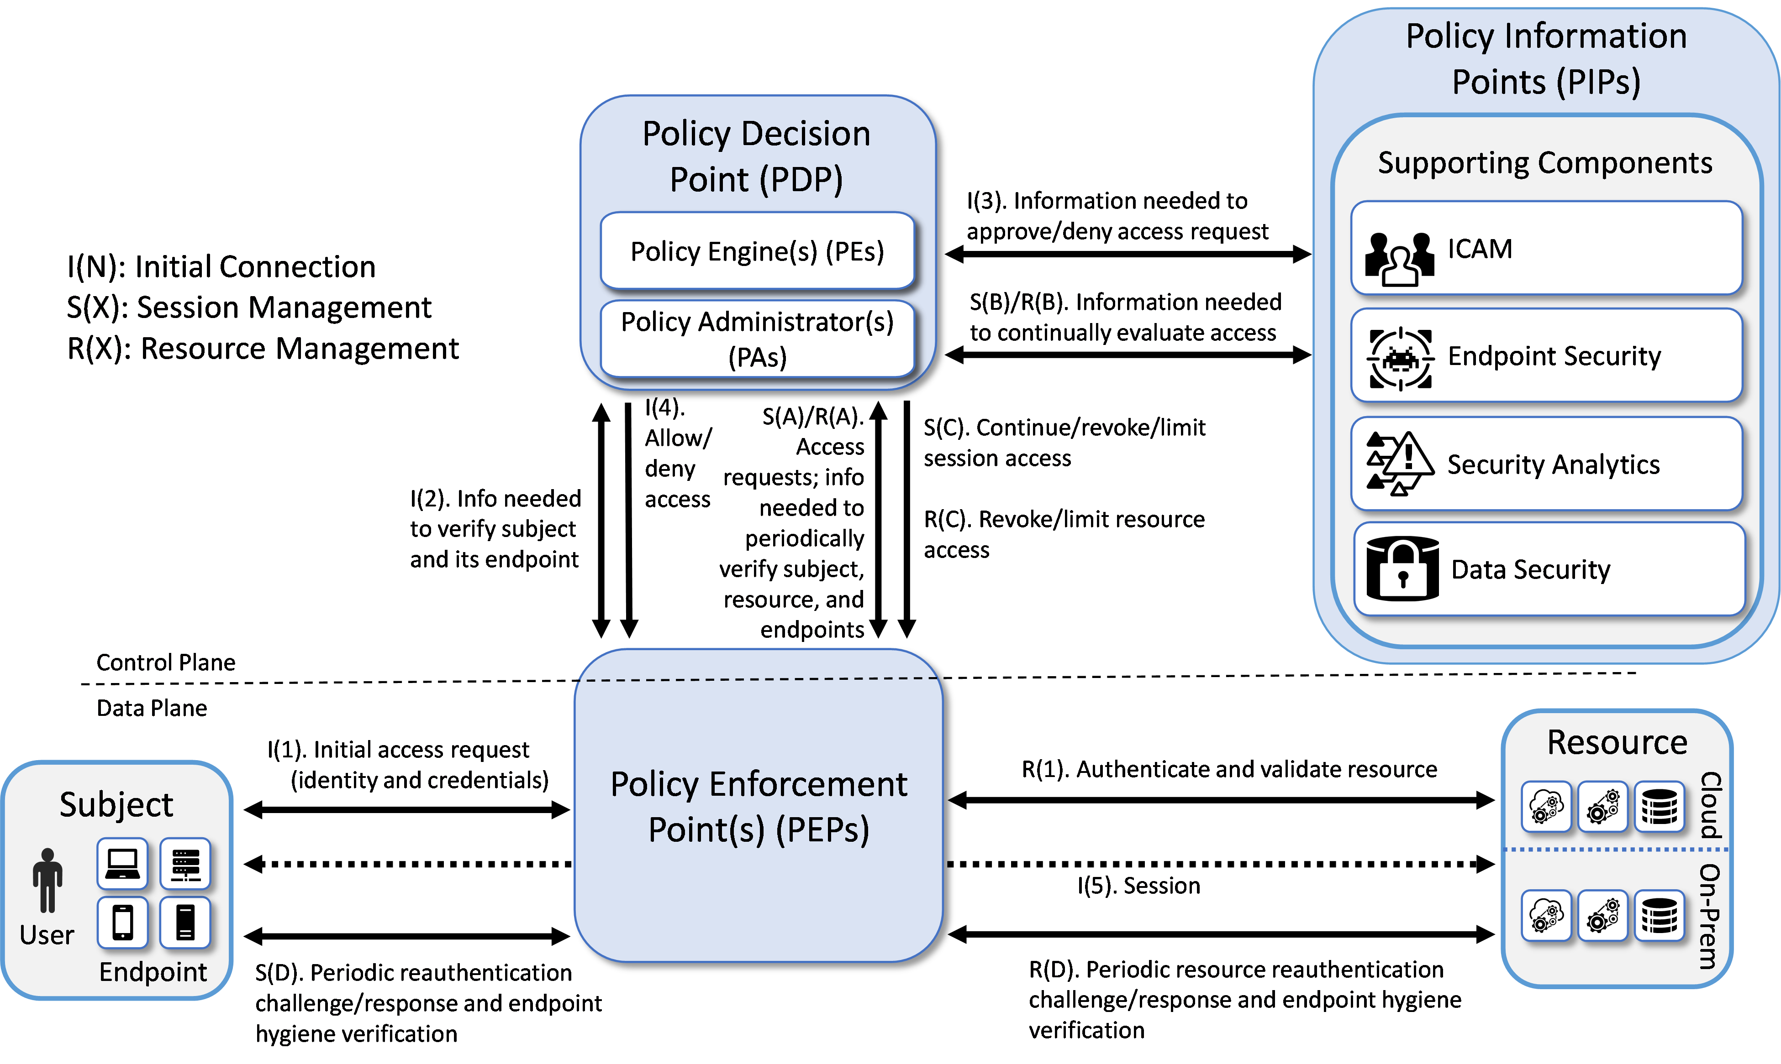
Decision and enforcement are separate
Zero-trust architecture makes the implementation picture concrete
Policy engine: ultimate grant / deny / revoke decision
Policy administrator: carries the decision out
Policy enforcement point: guards the resource
Identity, device, analytics, and data sources inform policy
Source: NCCoE / NIST SP 1800-35 supplementary documentation, “Architecture and Builds,” Figure 1
Northstar Group • evidence-led access-control curriculum
4
Created with AskAnything · askanything-app.com

Slide 5
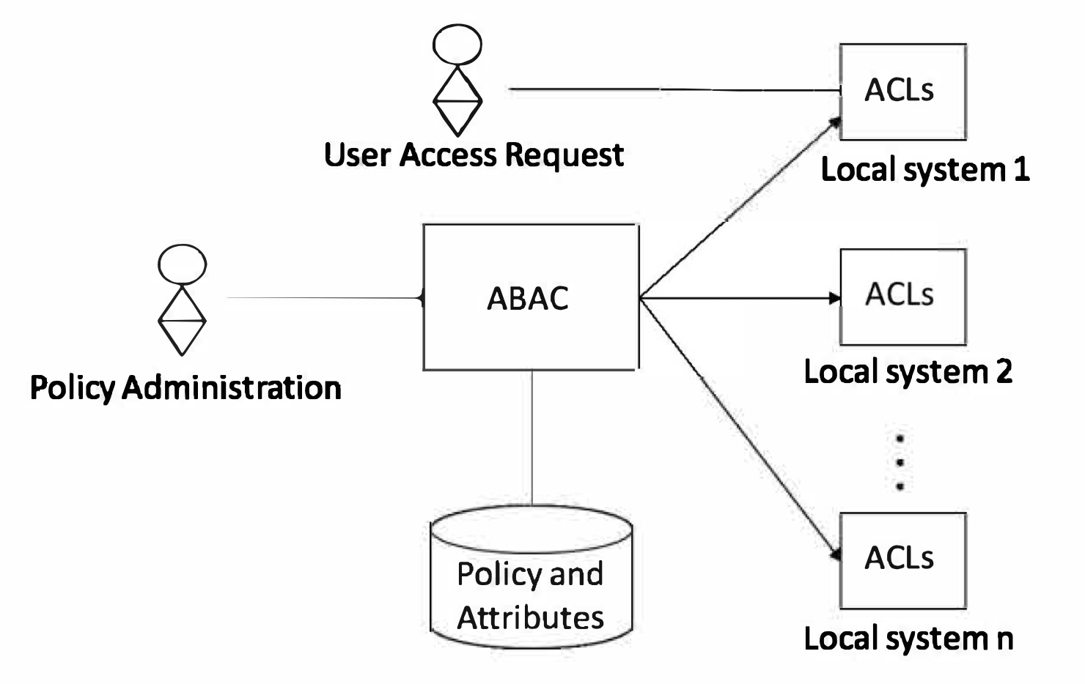
Central ABAC can coexist with local ACLs
Different access-control lenses can operate at different layers
Enterprise ABAC policy can be centrally administered.
Local native ACL mechanisms can enforce translated decisions.
A DAC-style local mechanism does not erase higher-order policy.
Source: NIST, “A Method and System for Centralized ABAC Policy Administration and Local Policy Decision and Enforcement Using Access Control Lists”
Northstar Group • evidence-led access-control curriculum
5
Created with AskAnything · askanything-app.com

Slide 6
Teach a local combining rule
Instructional sequence—not a universal implementation order
1 Identity + session facts
2 RBAC baseline
3 ABAC + explicit rules
4 MAC constraints
5 DAC inside the boundary
6 Enforce • log • re-evaluate
Example enterprise rule: explicit deny or mandatory constraint overrides a discretionary grant; no applicable permit yields deny; indeterminate results fail closed and escalate.
Northstar Group • evidence-led access-control curriculum
6
Created with AskAnything · askanything-app.com

Slide 7
Audience tiers follow decisions—not seniority
Task, Knowledge, and Skill statements support role-relevant assessment
All workforce and contractors: request, use, share, report
Managers, owners, stewards: approve, classify, review exceptions
HR / identity: authoritative attributes and joiner–mover–leaver events
IAM / security / platform: roles, labels, rules, decision and enforcement
Service desk / IR / privacy / legal / audit: diagnose, preserve evidence, test
Terminal performance: decompose → compute → detect bad evidence → act → explain.
Northstar Group • evidence-led access-control curriculum
7
Created with AskAnything · askanything-app.com

Slide 8
Core learning journey: 75–90 minutes
Short chapters culminate in policy-combining and operational action
0–2
3–5
6–9
Diagnostic • common notation • DAC boundary
RBAC + SoD • ABAC assurance • MAC non-override
Rule-BAC ambiguity • combining • response • capstone briefing
Recurring fictional enterprise + recurring people, resources, policies, and audit trail = visible consequences when facts change.
Northstar Group • evidence-led access-control curriculum
8
Created with AskAnything · askanything-app.com

Slide 9
Six simulations make overlap unavoidable
Participants request evidence rather than receiving the whole picture
Traveling payroll approver
Clinical researcher + patient record
Contractor project change
Merger data room
Ransomware break-glass
AI assistant + confidential source
Recurring test: which evidence applies, which constraint governs, who has authority, and what action is safe?
Northstar Group • evidence-led access-control curriculum
9
Created with AskAnything · askanything-app.com

Slide 10
A scored decision captures more than outcome
Recommended qualification is a governance choice—not a NIST mandate
Outcome: permit / deny / limit / step-up / revoke / escalate
Applicable policy lenses and decisive authoritative facts
Conflict-combining rationale and operational follow-up
Confidence and decision time
80% overall
≥70% on coverage + precedence
Zero critical unsafe permits
Privileged policy authors: proposed 90% + every critical case correct
Northstar Group • evidence-led access-control curriculum
10
Created with AskAnything · askanything-app.com

Slide 11
Analytic rubric: rationale carries the score
Unsafe permits are critical errors
Constraint coverage
25%
Decision + precedence
25%
Evidence quality
15%
Operational response
15%
Request decomposition
10%
Explanation + handoff
10%
Critical examples: ignoring a mandatory deny, inventing authority, or broadening access to close a ticket.
Northstar Group • evidence-led access-control curriculum
11
Created with AskAnything · askanything-app.com

Slide 12
Cross-functional tabletop reveals partial truths
45–60 minutes • teams of five to seven
HR holds identity record
Data steward holds classification and purpose
IAM holds role map
Security holds device and threat telemetry
Manager holds business objective
Audit holds decision log
No one receives the whole picture.
Score the final decision—and whether the team asks for missing evidence, resolves contradictions, preserves an audit trail, and uses the documented exception owner.
Northstar Group • evidence-led access-control curriculum
12
Created with AskAnything · askanything-app.com

Slide 13
Measure learning, behavior, and results
Completion is implementation data—not proof of competence
Reaction
Relevance • clarity • accessibility
Learning
Posttest • unsafe-permit rate • retention
Behavior
Request quality • remediation • escalation
Results
Exposure time • grants • findings • impact
Interpret organizational results cautiously: many factors beyond training influence them.
Northstar Group • evidence-led access-control curriculum
13
Created with AskAnything · askanything-app.com

Slide 14
Implementation guardrails
Training cannot repair defective authorization design
Validate every simulated rule and exception with policy owners.
Test accessibility, usability, and representative comprehension.
Pilot item difficulty, discrimination, timing, and scoring consistency.
Refresh when policy, regulation, architecture, attributes, or exception paths change.
Feed recurring failures back to IAM and policy owners; do not relabel design defects as user error.
Practical goal: safe action, explicit authority, reliable evidence, and a provable decision.
Northstar Group • evidence-led access-control curriculum
14
Created with AskAnything · askanything-app.com

Slide 15
Sources
NIST SP 800-50 Rev. 1 — learning-program lifecycle, assessment, evaluation
NISTIR 7316 — access-control taxonomy and Rule-BAC ambiguity
NIST SP 800-162; SP 800-205 — ABAC and attribute assurance
NIST RBAC project and glossary; MAC, DAC, SoD glossaries
NICE Workforce Framework Playbook — Task, Knowledge, Skill alignment
NIST SP 800-207; SP 1800-35 architecture — zero trust decision/enforcement
Kuhn et al. — pseudo-exhaustive ABAC testing
NIST centralized ABAC / local ACL technology description
Complete linked source ledger appears in answer.pdf and answer.docx.
Explore more questions at Ask Anything
Northstar Group • evidence-led access-control curriculum
15
Created with AskAnything · askanything-app.com

