Slide 1
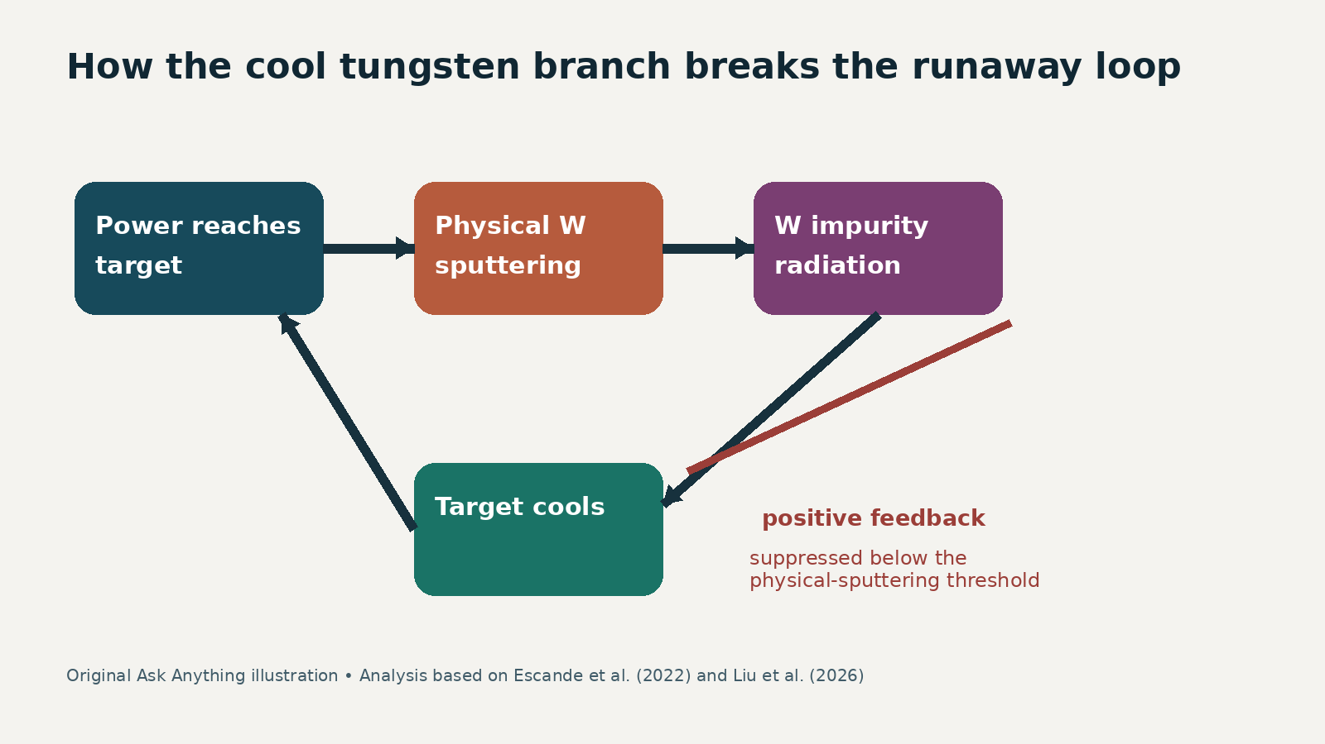
A startup trajectory—not brute-force density
01
1.65 nG
line-averaged density on EAST
Source: Liu et al., Science Advances 12, eadz3040 (2026)
Created with AskAnything · askanything-app.com

Slide 2
The claim in one causal chain
02
Higher D₂ prefill + up to 600 kW ECRH during ohmic startup
Cleaner startup and progressively conditioned wall
Cooler tungsten target → physical sputtering switches down
Lower Zₑff and radiation → higher density before collapse
Analysis: Escande et al. (2022); Liu et al. (2026)
Created with AskAnything · askanything-app.com

Slide 3
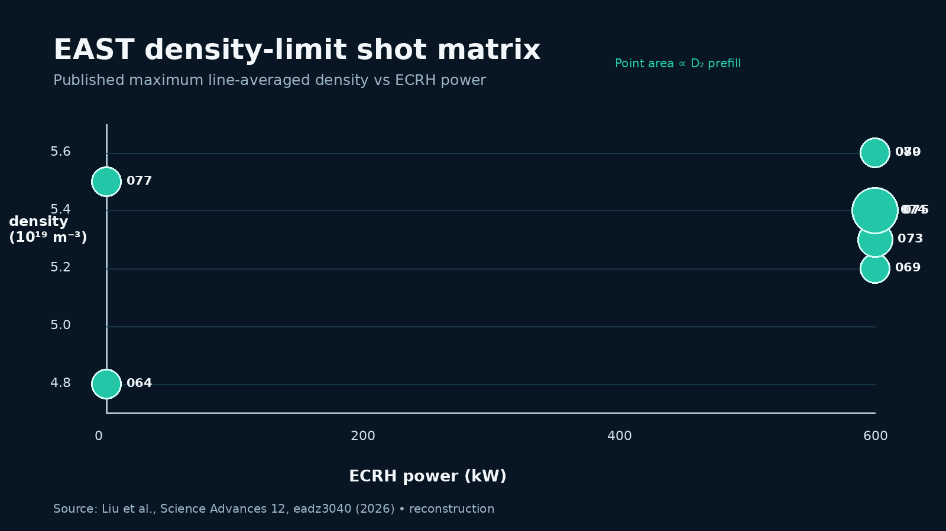
Eight shots map the accessible branch
03
Prefill scan at ~600 kW rose then saturated
ECRH-only increment was weak at lowest prefill
Same inputs, different shot history: wall state mattered
Source: published Table 1, reconstructed
Created with AskAnything · askanything-app.com

Slide 4
The diagnostic pattern matches reduced impurity feedback
04
Higher-performing shots: lower target Tₑ
Lower effective charge Zₑff
Lower total radiation
Density maximum rose to 4.8–5.6 ×10¹⁹ m⁻³
target Tₑ ↓
Zₑff ↓
density ↑
Source: Liu et al. (2026), Figs. 2–3
Created with AskAnything · askanything-app.com

Slide 5
“Density-free” is a model basin
05
PWSO fixed point: R₊ = α(P−R)
Runaway boundary occurs when loop gain α > 1
On cool tungsten, sputtering yield collapses below threshold
Predicted density threshold then moves sharply upward
warm target
sputtering active
finite limit
→
cool target
sputtering suppressed
density-free basin
Analysis: PWSO model; source Escande et al., Nuclear Fusion 62 (2022)
Created with AskAnything · askanything-app.com

Slide 6
Why tungsten enables—and endangers—the branch
06
Carbon: chemical sputtering persists at low energy
Tungsten: physical sputtering has an energy threshold
Below threshold, impurity source can switch down
Above it, trace high-Z radiation remains hazardous
Analysis: PWSO; EAST tungsten experiment
Created with AskAnything · askanything-app.com

Slide 7
What the experiment did not demonstrate
07
Not unlimited density: representative shot still terminated near 1.5 nG
Not a separatrix result: edge density stayed below 0.75 nG
Not burning H-mode: ~250 kA ohmic/ECRH-assisted scenario
No reported long dwell at 1.65 nG or gain improvement
MODEL\nBASIN\n≠\nNO LIMITS
Created with AskAnything · askanything-app.com

Slide 8
The next test is integrated, causal, and state-aware
08
Factor prefill, ECRH waveform, lithiation, and shot order
Control to target Tₑ, W influx, radiation topology—not settings alone
Report dwell above nG, confinement, erosion, and disruption margin
Demonstrate reversibility across the sputtering threshold
STARTUP
WALL STATE
DENSITY RAMP
H-MODE / BURNING
Analysis: proposed validation program based on reported limitations
Created with AskAnything · askanything-app.com

Slide 9
Bottom line: a controllable feedback branch
09
ECRH + neutral prefill changed the startup path
Cool, conditioned tungsten suppressed physical sputtering
Impurity radiation stayed low enough to reach 1.65 nG
Promising boundary physics; reactor integration remains open
CONTROL\nTHE WALL–PLASMA\nLOOP
Created with AskAnything · askanything-app.com

Slide 10
Sources
10
Liu et al. Science Advances 12, eadz3040 (2026). doi:10.1126/sciadv.adz3040
Escande et al. Nuclear Fusion 62, 026001 (2022). doi:10.1088/1741-4326/ac3a65
Liu et al. Nuclear Fusion 63, 096009 (2023). doi:10.1088/1741-4326/ace91c
Greenwald. PPCF 44, R27 (2002). doi:10.1088/0741-3335/44/8/201
Ding et al. Nature 629, 555 (2024). doi:10.1038/s41586-024-07313-3
Full bibliography and working hyperlinks: companion answer.md / answer.pdf / answer.docx
Explore more questions at Ask Anything
Created with AskAnything · askanything-app.com

