Slide 1
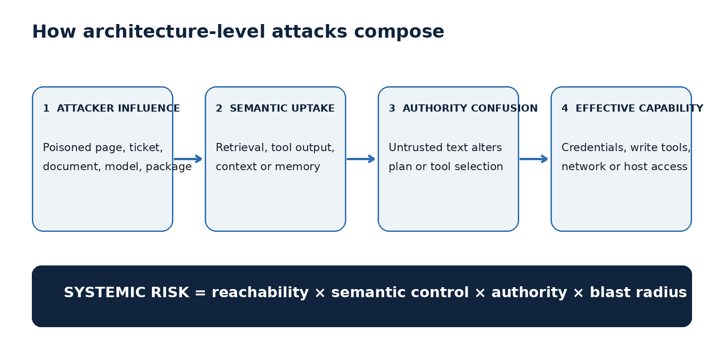
Architecture-level attacks compose
RAG, embeddings, agents, and supply chain are one trust-boundary problem.
ASK ANYTHING • ADVANCED TECHNICAL BRIEF
Created with AskAnything · askanything-app.com
Notes:
Full bibliography and direct hyperlinks are in answer.md, answer.pdf, and answer.docx. Speaker focus: Architecture-level attacks compose. RAG, embeddings, agents, and supply chain are one trust-boundary problem.

Slide 2
The model is inside a deterministic control plane
Untrusted content → semantic decision → privileged capability → external effect
Analysis: Ask Anything synthesis; evidence in companion report.
Created with AskAnything · askanything-app.com
Notes:
Full bibliography and direct hyperlinks are in answer.md, answer.pdf, and answer.docx. Speaker focus: The model is inside a deterministic control plane. Untrusted content → semantic decision → privileged capability → external effect

Slide 3
RAG retrieves relevance—not authority
• Indirect instructions ride inside documents, pages, tickets, and tool results
• Provenance and access control must survive chunking
• Prompt delimiters help, but do not authorize actions
Source: Greshake et al., arXiv:2302.12173.
Created with AskAnything · askanything-app.com
Notes:
Full bibliography and direct hyperlinks are in answer.md, answer.pdf, and answer.docx. Speaker focus: RAG retrieves relevance—not authority. • Indirect instructions ride inside documents, pages, tickets, and tool results • Provenance and access control must survive chunking • Prompt delimiters help, but do not authorize actions

Slide 4
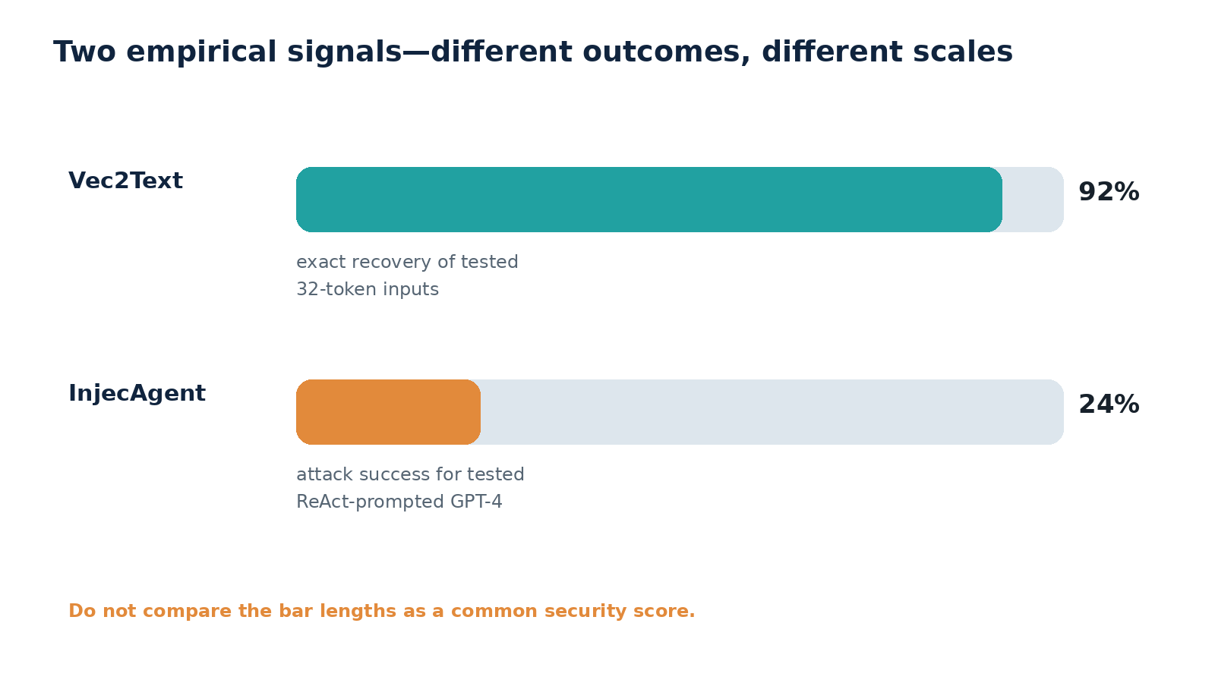
Benchmarks confirm material residual risk
• InjecAgent: 1,054 cases across 79 tool roles
• ReAct-prompted GPT-4: 24% attack success in the reported setup
• AgentDojo jointly exposes security and utility failures
Source: InjecAgent (ACL 2024); AgentDojo (NeurIPS 2024).
Created with AskAnything · askanything-app.com
Notes:
Full bibliography and direct hyperlinks are in answer.md, answer.pdf, and answer.docx. Speaker focus: Benchmarks confirm material residual risk. • InjecAgent: 1,054 cases across 79 tool roles • ReAct-prompted GPT-4: 24% attack success in the reported setup • AgentDojo jointly exposes security and utility failures

Slide 5
Embeddings are sensitive derivatives
• Vec2Text recovered 92% of tested 32-token inputs exactly
• But it used a trained decoder and encoder query access
• Protect vectors like source text; do not embed secrets
Source: Morris et al., arXiv:2310.06816.
Created with AskAnything · askanything-app.com
Notes:
Full bibliography and direct hyperlinks are in answer.md, answer.pdf, and answer.docx. Speaker focus: Embeddings are sensitive derivatives. • Vec2Text recovered 92% of tested 32-token inputs exactly • But it used a trained decoder and encoder query access • Protect vectors like source text; do not embed secrets

Slide 6
Agency converts language failure into state change
• Separate read and write capabilities
• Issue short-lived, task-scoped credentials
• Require deterministic policy and step-up approval
• Score actual unauthorized effects—not phrase following
Source: OWASP LLM06:2025; InjecAgent.
Created with AskAnything · askanything-app.com
Notes:
Full bibliography and direct hyperlinks are in answer.md, answer.pdf, and answer.docx. Speaker focus: Agency converts language failure into state change. • Separate read and write capabilities • Issue short-lived, task-scoped credentials • Require deterministic policy and step-up approval • Score actual unauthorized effects—not phrase following

Slide 7
MCP standardizes tools, not trust
• Official guidance covers confused deputy, SSRF, token passthrough, sessions, and local servers
• Pin and review servers; bind token audience
• Sandbox local execution and validate every redirect
Source: modelcontextprotocol.io security best practices.
Created with AskAnything · askanything-app.com
Notes:
Full bibliography and direct hyperlinks are in answer.md, answer.pdf, and answer.docx. Speaker focus: MCP standardizes tools, not trust. • Official guidance covers confused deputy, SSRF, token passthrough, sessions, and local servers • Pin and review servers; bind token audience • Sandbox local execution and validate every redirect

Slide 8
The AI supply chain extends beyond weights
• Checkpoints, tokenizers, configs, packages, containers, tools, and hosted services
• Prefer non-executable tensor formats
• Promote artifacts from an isolated, no-secret environment
Source: Hugging Face pickle security; PyTorch serialization.
Created with AskAnything · askanything-app.com
Notes:
Full bibliography and direct hyperlinks are in answer.md, answer.pdf, and answer.docx. Speaker focus: The AI supply chain extends beyond weights. • Checkpoints, tokenizers, configs, packages, containers, tools, and hosted services • Prefer non-executable tensor formats • Promote artifacts from an isolated, no-secret environment

Slide 9
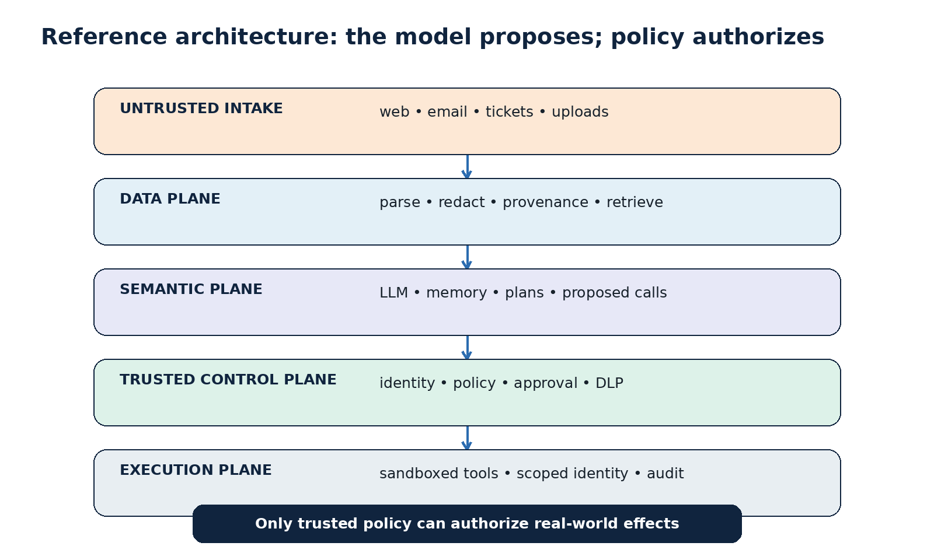
The model proposes; trusted policy authorizes
Five zones separate intake, data, semantics, control, and execution.
Analysis: Ask Anything reference architecture.
Created with AskAnything · askanything-app.com
Notes:
Full bibliography and direct hyperlinks are in answer.md, answer.pdf, and answer.docx. Speaker focus: The model proposes; trusted policy authorizes. Five zones separate intake, data, semantics, control, and execution.

Slide 10
A 90-day defensive program
0–30: inventory, remove write scope, block egress, pin artifacts
30–90: provenance, typed actions, external policy, trajectory tests
90+: capability architecture, attestations, inversion testing
Analysis: Ask Anything implementation synthesis.
Created with AskAnything · askanything-app.com
Notes:
Full bibliography and direct hyperlinks are in answer.md, answer.pdf, and answer.docx. Speaker focus: A 90-day defensive program. 0–30: inventory, remove write scope, block egress, pin artifacts 30–90: provenance, typed actions, external policy, trajectory tests 90+: capability architecture, attestations, inversion testing

Slide 11
Sources
Greshake et al. 2023 — arXiv:2302.12173
Zhan et al. 2024 — ACL Findings 10.18653/v1/2024.findings-acl.624
Debenedetti et al. 2024 — NeurIPS AgentDojo
Morris et al. 2023 — arXiv:2310.06816
MCP Security Best Practices; OWASP LLM06:2025
Explore more questions at Ask Anything
Created with AskAnything · askanything-app.com
Notes:
Full bibliography and direct hyperlinks are in answer.md, answer.pdf, and answer.docx. Speaker focus: Sources. Greshake et al. 2023 — arXiv:2302.12173 Zhan et al. 2024 — ACL Findings 10.18653/v1/2024.findings-acl.624 Debenedetti et al. 2024 — NeurIPS AgentDojo Morris et al. 2023 — arXiv:2310.06816 MCP Security Best Practices; OWASP LLM06:2025

